Slide 1
Singapore
Bomin and mia

Slide 2
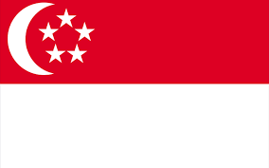
Introduction
1819, British founded modern Singapore as trading colony
1963, Joined Malaysian Federation
1965, Became Independent
One of the world’s most prosperous countries
GDP Per Capita equal to leading nations of Western Europe
Notes:
The Republic of Singapore is located in Southern Asia between Malaysia and Indonesia.
In 1819, the British founded modern Singapore as a trading colony.
In 1963, Singapore joined the Malaysian Federation and two years later they became an independent country.
Singapore is one the world’s most prosperous countries with strong international trading links.
They have a population of almost 6 million as of 2023.
Singapore’s official languages are Malay, English, Tamil, and Mandarin, but Mandarin is mostly spoken throughout.
They have a national symbol of a lion, merlion ( mythical half lion- half fish creature), and orchid
And their national colours are red and white as you can see in their flag.

Slide 3
Introduction
Labor Force – by Occupation
Agriculture: 0.7%
Industry: 25.6%
Services: 73.7%
Free-market economy with dirigiste characteristics
#1 in Economic Freedom Ranking
Overall 84.4%
Notes:
Singapore is a parliamentary republic Known for financial arrest and Asian Infrastructure Exchange; business-driven regulations; and low unemployment;
Labor Force is divided with 73.7% in services, 25.6% in industries, and 0.7% in agriculture.
Singapore has a highly developed free-market economy with command economy characteristics.
Singapore is ranked 1st in the country rankings of the Index of Economic Freedom with an overall percentage of 84.4%,.

Slide 4
Real GDP $578.254 billion (2021)
GDP per capita
GDP composition
$106,000 (2021)
$94,500 (2020)
$98,300 (2019)
Agriculture: 0.0%
Industry: 24.8%
Services: 75.2%
Notes:
Real GDP of Singapore as of 2021 was $578.254 billion
7.61% (2021 est.) -4.14% ( 2020 est.) 1.1% (2019 est.)
GDP per capita measures the economic output of a nation per person
GDP composition by sector of origin shows the percentage division of where production takes place in the economy

Slide 5
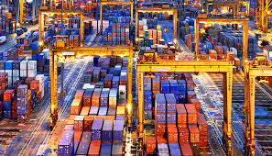
Exports
Exports
・$733.782 billion (2021 est.) ・$627.442 billion (2020 est.) ・$658.127 billion (2019 est.)
Singapore is ranked 10th
Export Commodities
・ integrated circuits, refined petroleum, gold, gas turbines, packaged medicines (2019)
Exports-Partners
・ China 15%, Hong Kong 13%, Malaysia 9%, United States 8%, Indonesia 7%, India 5% (2019)
Notes:
Exports mainly support Singapore’s society.
Every year Singapore's exports go up,
658.127 billion (2019)
627.442 billion (2020)
733.782 billion (2021)
Singapore is positioned 10th in the export ranking.
Singapore derives most of its revenues from foreign trade. The biggest export product, with 43 percent share, is machinery and equipment. The other commodities are integrated circuits, refined petroleum, and ect…
Singapore's trading partners are China 15%, Hong Kong 13%, Malaysia 9%, US 8%, Indonesia 7%, India 5%

Slide 6
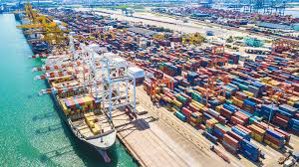
Imports
Imports
・$609.280 billion (2021 est.) ・$517.967 billion (2020 est.) ・$550.209 billion (2019 est.)
Singapore is ranked 12th
Import commodities
integrated circuits, refined petroleum, crude petroleum, gold, gas turbines (2019)
Import Partners
China 16%, Malaysia 11%, United States 9%, Taiwan 7%, Japan 5%, Indonesia 5% (2019)
Notes:
Similar to exports, imports have gone up recently,
550.209 billion (2019)
517.967 billion (2020)
609.280 billion (2021)
Singapore is ranked 12th in the world imports ranking
Their main import products are integrated circuits, refined petroleum, and ect.
Their principle import partners are China, Malaysia, US, Taiwan, Japan, and Indonesia.

Slide 7
Short video
https://youtu.be/6f7pd5P9jlA

Slide 8
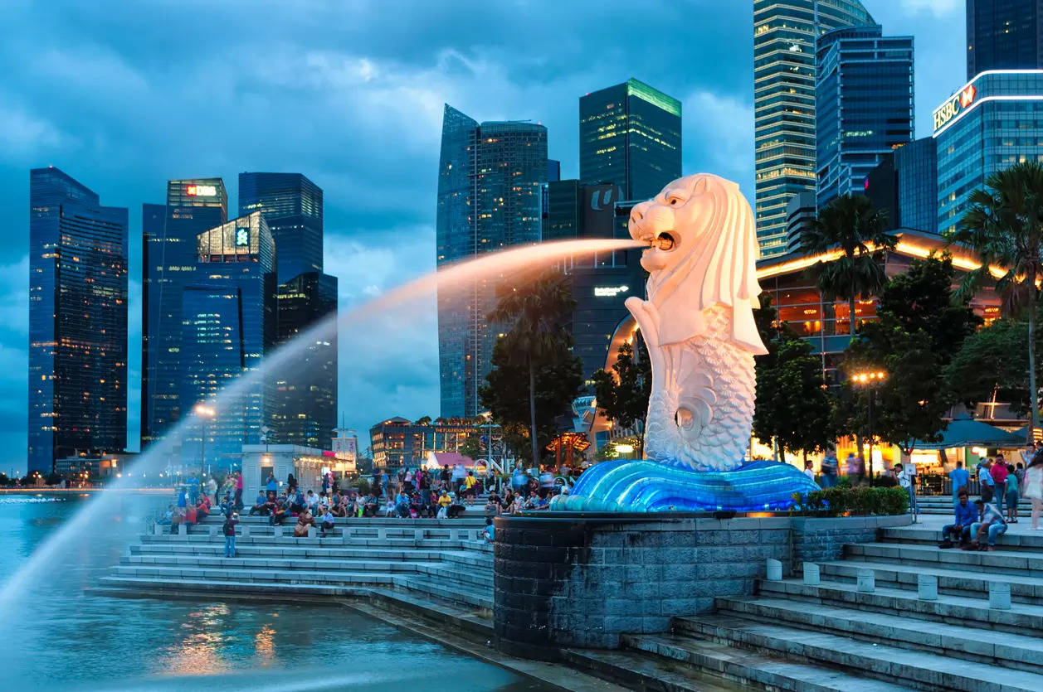
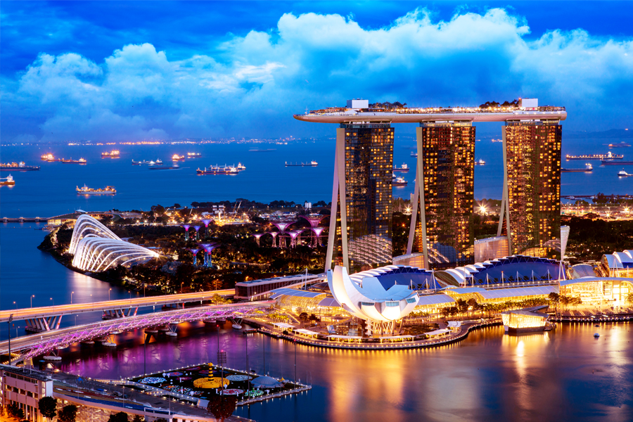
Tourism
2018, 19.12 million visitors
2022, 6.30 million
Since 2010, new tourist facilities
Botanic Gardens, Gardens by the Bay, Marina Bay (Casino)
Universal Studios, National Museum, Zoo and Night Safari
Tourists form Asia
Notes:
Before the pandemic in 2018, Singapore had 19.12 million visitors annually, but in 2022 they only had 6.3 million visitors, which is around a third of the visitors they usually have.
Since around 2010, many new tourist facilities have been built, attracting attention on social medias and attracting an increasing number of tourists, especially young people
In 2022 and 2023, tourism is once again booming among Asian tourists, especially form China, Japan, and South Korea.
Gardens by the Bay is a national garden and horticultural attraction.
Marina Bay Sands is a five-star hotel resort, which is known for its unusual design of a floating ship.
Casinos are allowed in Singapore in the form of integrated resorts (IR), such as Marina Bay Sands and Resorts World Sentosa, where the casino is integrated in a major resort property that includes a hotel, together with convention facilities, entertainment shows, theme parks, luxury retail and fine dining.

Slide 9
Bibliography
https://www.cia.gov/the-world-factbook/
https://www.iseas.edu.sg/articles-commentaries/iseas-perspective/2021-108-covid-19s-economic-impact-on-tourism-in-singapore-by-joey-erh/
https://www.stb.gov.sg/content/stb/en/media-centre/media-releases/Singapore-tourism-sector-recovers-strongly-in-2022-visitor-numbers-expected-to-double-in-2023.html
https://www.casino.org/news/singapore-casinos-benefiting-from-increased-visitation/

