Slide 1
ADL Project Lightbulb
Made by Chris

Slide 2
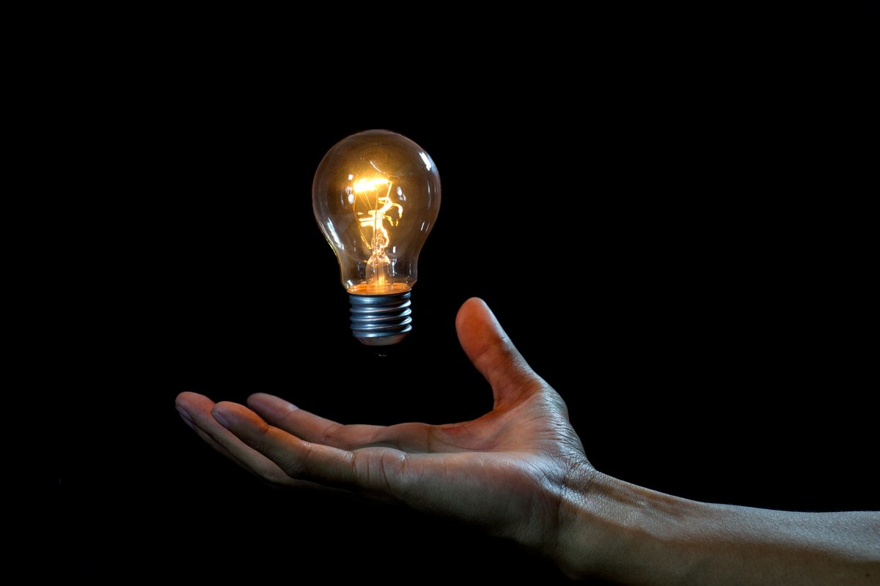
About Lightbulb
Invented by Thomas Edison
First invented in 1879
Produces light by filament getting hot which glows up

Slide 3
The Purpose During the Industrial Rev
Lightbulb was invented to give off lights to darkness. Before the invention of lightbulb, people weren't able to look or move around at night or places where sunlight couldn't reach in comfortably. However, after Thomas Edison's invention of lightbulb was successful, people were able to look or go to the direction where they are heading without bumping their heads.
Although the invention of lightbulb was a big hit during the industrial revolution, there were still some places to be developed

Slide 4
Problem Since Creation
When the first idea from Thomas Edison's rival, Joseph Swan was revealed to the world, there was a problem of using the filament which burnt out too fast. They needed to find another material that fits for making better lightbulbs.

Slide 5
Consequences of problem
Safety
Efficientcy
Short lifespan
The first light bulb that was invented used filament to glow. Therefore, filament which burns out quickly will make the glass shatter because of the heat.
The incandescent light bulbs invented in 1879 wasn't bright enough to shine a big area. Also, the incandescent light bulb that Thomas Edison made used up too many energy.
The lightbulbs made in 19th century didn't last longer compare to the LED lighbulbs we nowadays use a lot.

Slide 6
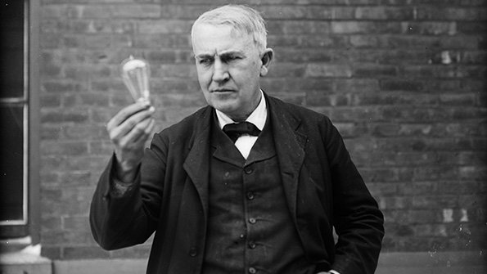
What were the Solutions Utilized?
As time went by, the glass surrounding the bulb were hardened which prevents the glass from shattering. In addition, Edison continued the research using carbonized filament of uncoated cotton thread for the next 10 years which eventually made the bulb last longer than before.

Slide 7
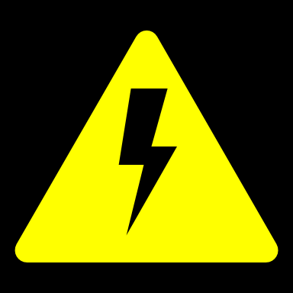
Any Current Solutions?
For several years, most efficient and well known bulb was the incandescent bulb. However, nowadays people use LED bulbs instead of incandescent bulb. The reason is that LED bulbs are bery efficient on energy, and it can cover the stylish part that incandescent bulb couldn't. Also, the current solution of using less energy by using LED bulb give people positive consequences of saving their money. Finally, the coolness of the LED bulb keeps people safe from accidentally touching the bulb and getting their hands burnt.

Slide 8
About innovation
In my opinion, innovation is a huge change happening similar like revolution but using ideas and thoughts or even inventions.
Innovation is usually functioned by the smart inventors who changes people's thought and brings solutions to the world which is needed. When innovation occurs, the invention is easily accessable, make things efficient, which also has a bad part that leads people to laziness.

Slide 9
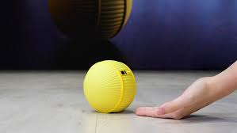
My Own Solutions (future suggestion)
I think the light bulb will be the most popular and most bought in the stores if the light bulb works as Samsung's artificial intelligent robot that follows the owner and helps whatever the owners do.
To start off, I think it will be way comfortable and more helpful if the lightbulb transforms into a ball form that has a camera on front that detects the owner and follow wherever the owner goes. Then, the owners won't have to use their hands to hold a flashlight or their phone. In addition, it would be energy saving and both environment saving to attach a solar energy system on the ball formed light bulb. As I have mentioned, this will help save the energy unlike the bulbs attached on the ceiling using up energy all the time when it is shining. Therefore, I think the future light bulb can be developed into a ball form that uses solar enegry to work and follows you wherever you go to shine your delightful path.

Slide 10
Thank you Mr. Basso

Slide 11
Bibliography
Burke, James. “Invention.” Encyclopædia Britannica, Encyclopædia Britannica, Inc., 12 June 2018, www.britannica.com/technology/invention-technology.
“Light Bulb (1879) - Industrial Revolution.” Google Sites, sites.google.com/site/johnjohnindustrialrevolution/light-bulb-1879.
“The History of the Light Bulb.” Energy.gov, www.energy.gov/articles/history-light-bulb.
Holman, Ryan. “Top 8 Benefits of Using LED Lights.” Lifehack, Lifehack, 10 Feb. 2017, www.lifehack.org/533944/top-8-benefits-using-led-lights.

