Slide 1
Optimizing Athletic Performance Academy

Slide 2
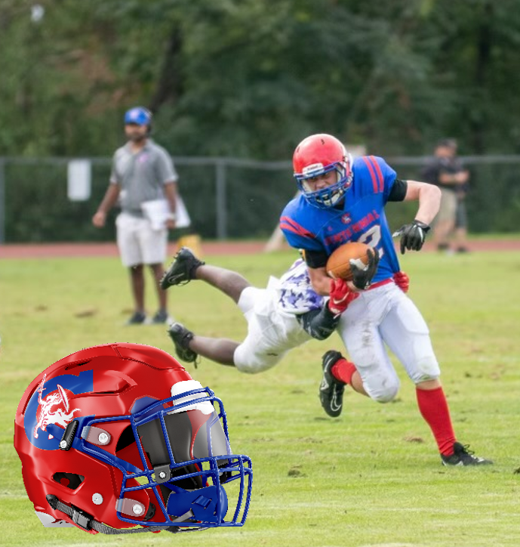
FOOTBALL
For more information on our football program
and this class, complete form here:
https://forms.office.com/r/XFWj2eXwSN

