Slide 1
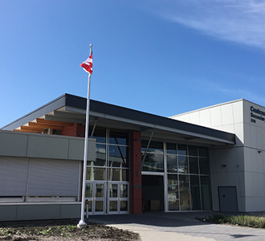
2024-2025 COURSE PLANNING Grades 9-11

Slide 2
Graduation Requirements
Grade 10-12 Courses Credited
52 Credits Required Courses
28 Elective Courses
80 Credits Total
Literacy and Numeracy Assessments

Slide 3
Required Courses
An English 10, 11 and 12
Social Studies 10
A Social Studies 11 or 12
Science 10
A Science 11
A Mathematics 10
A Mathematics 11
Physical and Health Education 10
A Fine Art/Applied Skill 10, 11 or 12
Career Life Education 10
Career Life Connections 12 (STARTS SEM 2 GRADE 11)

Slide 4
POST-SECONDARY EDUCATION
Vocational Programs
Technology Programs
College and University College Programs
University

Slide 5
VOCATIONAL PROGRAMS
Offered at Vancouver Community College (VCC) and BCIT
Some programs lead to designated trades and eventual completion of a full apprenticeship
Programs vary in length from a few weeks to two years

Slide 6
VOCATIONAL PROGRAMS
High school graduation
Rolling Application Dates and Deadlines
Some specific course requirements.

Slide 7
VOCATIONAL PROGRAMS
Sample BCIT Programs
Aviation
Sample VCC Programs
Office Administration
Drafting
Electronics
Mechanics
Marine
Construction
Manufacturing
Health Services
Food Services and Tourism
Technical Trades
Dental Assistant
Diesel Technician

Slide 8
LOCAL COLLEGES
Douglas College (some degree programs)
Langara College
Vancouver Community College (VCC)
Justice Institute of British Columbia (JIBC)
Link:https://www.douglascollege.ca/future-students/admission-information
Link:https://langara.ca/admissions/index.html
Link: https://www.vcc.ca
Link:https://www.jibc.ca/procedure/admissions

Slide 9
CAREER PROGRAMS
Horticulture
Business
Computing and Technology
Fine and Applied Arts
Health and Community Service

Slide 10
UNIVERSITY TRANSFER PROGRAMS
Complete 1 or 2 years of university course work at the college
Must complete at least 24-30 credits to transfer
Transfer based on college GPA

Slide 11
TECHNOLOGY PROGRAMS
Offered at BCIT and Kwantlen Polytechnic University (KPU)
2-3 year ‘Hands On’ programs
Degree Granting Programs in Traditional Academics

Slide 12
BC UNIVERSITY OPTIONS
University of British Columbia (UBC)
Simon Fraser University (SFU)
University of Victoria (UVIC)
Capilano University
Nicola Valley Institute of Technology
Kwantlen Polytechnic University (KPU)
British Columbia Institute of Technology (BCIT
Emily Carr University of Art and Design
Vancouver Island University (VIU)
Thompson Rivers University (TRU)
Trinity Western University (TWU)
Royal Roads University
University Canada West
University of Northern British Columbia (UNBC)
University of the Fraser Valley (UFV)
Quest University

Slide 13
SFU– Admissions Information
English Studies 12 with a minimum final grade of 70%.
All Grade 11 and 12 Approved Courses Count.
Minimum of 5 SFU Approved Grade 12 courses.
Check Faculty and Program Specific Requirements (Website)
Some programs will require a Supplemental Application.
Minimum Beginners Language 11

Slide 14
UBC – Admissions Information
ALL the grade 11 and 12 courses the student has completed are considered to make a holistic admissions decision except for ADST, Career Education and Physical Education
Minimum of 6 Grade 12 courses (Not all off Approved List)
Minimum Language 11
Personal Profile to complete. Some programs will also require a Supplemental Application.
Check Faculty and Program Specific Requirements (Website)
Minimum final grade of 70% in an English 11 or English Studies 12

Slide 15
English Studies 12 in Semester TWO
No, this is not a disadvantage for students applying to UBC, SFU, etc.
Universities will refer to Grade 11 marks.

Slide 16
Delta Challenge Exams
Challenge exam meets language requirement only for UBC. These are second language exams worth course credits.
Challenge exams for SFU and UVIC can be included in GPA calculation and fulfill the language requirement.

Slide 17
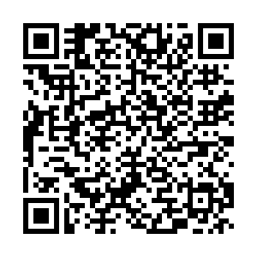
Post Secondary and Career Advisor Denise Healey Wright dhealeywright@sd43.bc.ca Visit Career Centre Website www.sd43.bc.ca/School/Centennial/ProgramsServices/CareerCentre Daily 8:00 am – 3:30 pm except Tuesdays
Awards & Bursaries
Employment Opportunities
Post-Secondary Options
Scholarships
Trades Training
Volunteering

Slide 18
Work Experience Program
Designed for Grade 11 and 12 students wishing to explore a chosen field while completing grad requirements.
4 Course Credits
30 hours in classroom and 90 hours in the community
18+ Work Experience Programs

Slide 25
COURSE PLANNING 2024-25

Slide 26
New(er) Courses 2024 -2025
Literary Studies 12 (Fear)
Optimized Athletic Performance Academy 11/12
Experiential Studies Academy
ADST Power Technology 10: Bicycles, small engines, automobiles
Fitness and Conditioning 11/12 :Football. Open to grades 9-11 Runs AM block November – June
Fitness and Conditioning 11/12 : Soccer. Open to grades 9-12. Runs in AM block Sept-Nov and April to June.

Slide 27
Dungeons& Dragons Adventures& Teamwork 11 Chess 10
Social Dynamics in Tabletop Role Playing Games focuses on friendship, leadership, and mental well-being as students engage in games like Dungeons & Dragons, Pathfinder, Polaris, Starfinder and more.
Although the main focus of the course is on peer interaction, participants will also design adventures, characters, monsters, encounters as well as learn the basics of 3d printing, painting, map production and other design elements.
There are no prerequisites for this course. Open to all grade levels.

Slide 28
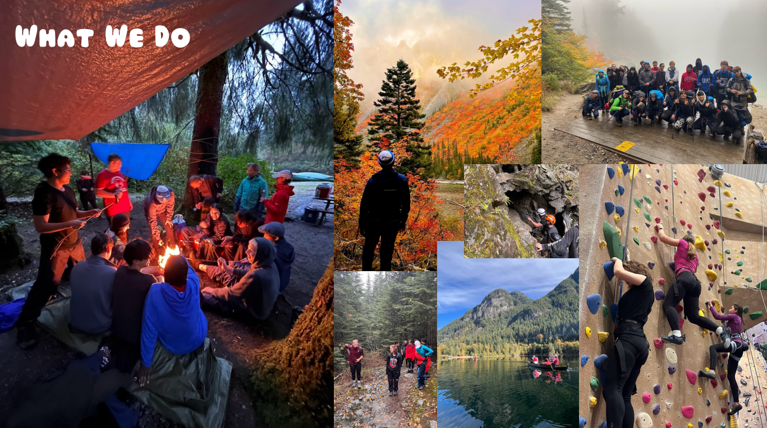
Credit for 6 Courses! Physical & Health Ed 10 CLE 10 Science 10 Socials 10 Earth Science 11 Outdoor Leadership 10
JUNIOR Environmental Studies Academy
2024/25 School Year
Take your Semester Outdoors!
Overnight Trips
Hiking
Community Building
First Aid
Canoe Certification
Bouldering
@cent.es

Slide 29
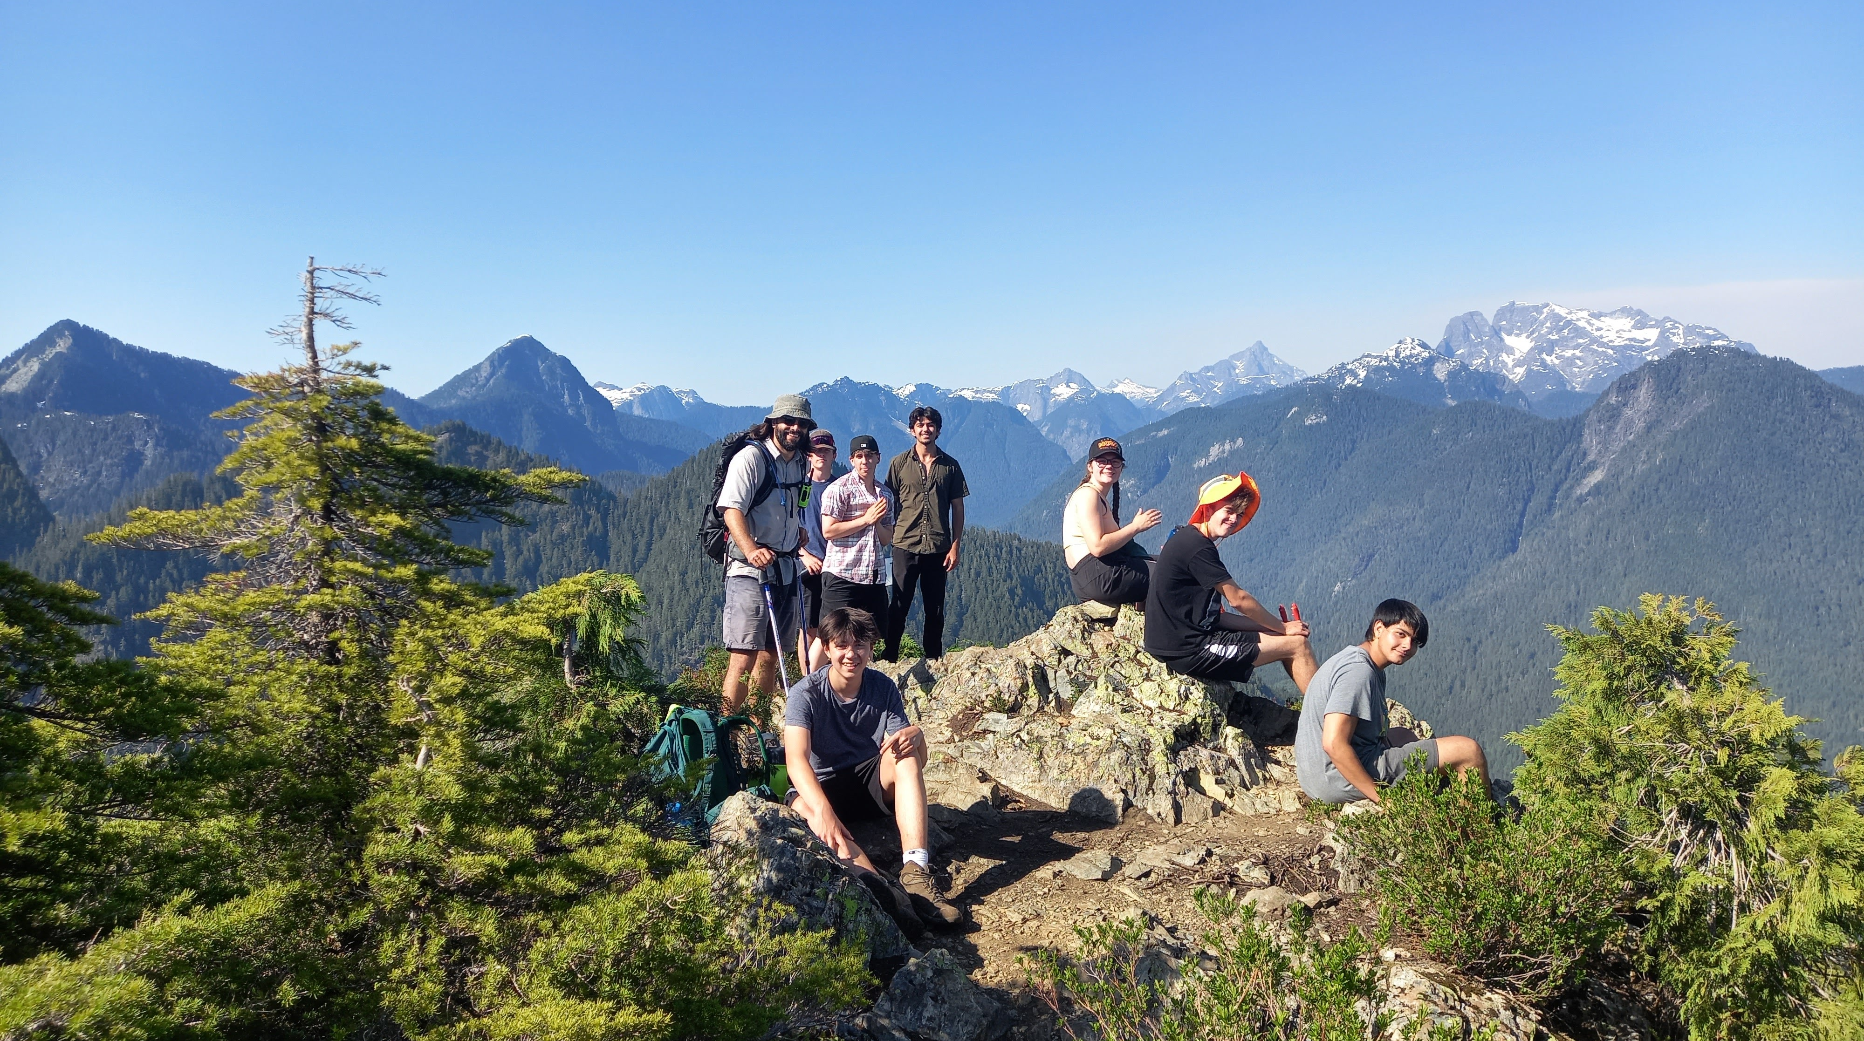
Credit for 6 Courses! Life Science 11 Environmental Science 11/12 BC First Peoples 12 English First Peoples 11/12 Outdoor Education 11/12 Outdoor Leadership 11/12
SENIOR Environmental Studies Academy
2024/25 School Year
Take your Semester Outdoors!
Overnight Trips
Hiking
Field Research
Community Building
Wilderness First Aid
Canoe Certification
Belay/Rock Climbing
@cent.es

Slide 33
Leadership Courses
Athletic Leadership 11/12
Peer Tutoring 11/12
Tech Leadership 10/11/12 (Off-Timetable)
Leadership 10/11/12 (Off-Timetable)

Slide 34
Leadership Courses
Motivated Grade 10, 11 and 12 students in Academics, Electives, Technology, PE or Volunteerism
Credit will be granted after successfully completing 90 hours of the course.
Leadership 10/11/12 is by application only. Students are not automatically admitted to the class without first, qualifying and second, completing the application process successfully. This class cannot be used as one of your 8 courses because the class occurs outside of the hours of the regular timetable.
WHEN TO APPLY: Applications will be made available at the same time as the Course Request forms. Complete the application by the deadline on the form, and then you will be able to select it on your Course Request form as one of your courses.
HOW TO QUALIFY: Be a student in good standing (excellent attendance record, no behaviour concerns); Be outgoing; Be chosen by the selection committee
Grade 10/11/12 Leadership Application Form: https://tinyurl.com/2p8549af

Slide 35
Peer Tutoring
Academically strong grade 11 and 12 students will be provided the opportunity to learn about themselves and develop their leadership skills by working with younger students in a classroom setting
Peer Tutoring requires an application form.
Credit will be granted after successfully completing this course
Athletic Leadership is peer tutoring but working with younger students in a P.E. class
Applications will be available in the online website

Slide 36
ADVANCED PLACEMENT (AP)
Obtain advanced credit or standing in select university courses
AP Biology, AP Chemistry, AP Calculus, AP Physics, AP Psychology are offered as courses at Centennial
Qualifying students may use these courses for university entrance requirements and may also receive credit for first year university courses.

Slide 37
GRADE 9 GOING INTO GRADE 10
You will have access to a fillable grade 10 form online
Make sure to identify what courses you have, or will have completed in grade 9.
You must have a minimum of 8 classes
Choose which of the two English 10 courses you want
Choose which of the two math courses you want
Tick off the remaining 5 required courses
Choose 2 electives in order of preference
Choose 4 ALTERNATE electives. These are courses you may get if we cannot get you your 2 preferred electives so make sure it is something you are willing to take. You may get one or more of these classes so choose wisely!
Identify any additional electives that are OUTSIDE the timetable (basketball, soccer, leadership etc)

Slide 38
GRADE 10 GOING INTO GRADE 11
You will have access to a fillable grade 11 form online
Make sure to identify what courses you have, or will have completed in grade 10.
You must have a minimum of 8 classes
Choose which Indigenous Grad Requirement you will take ((EFP11) or BCFP12
Choose which of the English courses you want in order of preference
Choose which of the socials studies courses you want in order of preference
Choose which math you want
Choose which science you want in order of preference. You can choose more than one by selecting 2,3,4 in your additional electives
Choose 4 electives in order of preference
Choose 3 ALTERNATE electives in order of preference. Choose wisely as you may get one or more of these alternates
Identify any additional electives that are OUTSIDE the timetable (basketball, soccer, leadership etc)
Identify your planned courses for grade 12. You are not committed to these

Slide 39
GRADE 11 GOING INTO GRADE 12
You will have access to a fillable grade 12 form online
Make sure you have explored your post secondary and graduation requirements
Discuss your courses with your parents or guardians
Indicate what courses you took in grades 10 and 11
Identify which English 12 course you want to have
Choose a minimum of 7 classes if you have at least 60 credits
Choose your 4 alternate electives in order of preference. You may get one or more of these courses so choose wisely
Choose any additional/off timetable courses
Indicate whether or not you are taking ES but choose courses assuming you will NOT get into the program
If you are applying to Train in Trades choose courses assuming you will NOT get into the program and make your last 4 courses the ones you are willing to drop should you be accepted into the program. Hand your application in to your counsellor along with your course selection sheet

Slide 40
Course selection input in MyEd by grade

Slide 41
KEYS TO SUCCESS
Utilize your class time wisely
Contact your teacher(s) if you are going to be away due to illness or vacation
Advisory – this is a block of time on Mondays where students are given the opportunity to organize their week, particularly with respect to their use of Flex and Cent Time.
Flex: this will be used for students to get help with their courses or work on homework and projects. CLC 12 (Career Life Connections), which is required for all grade 12 students will be taught through FLEX and CENT time.
CENT Time stands for Collaboration, Exploration, Networking, and Tutorial Time. It will serve several roles, including student Independent Direct Studies, to network with experts and professionals in a field to enhance learning, or a time to receive extra tutorial support. It may be used for guest presentations, assemblies, and an extended block for classes when needed.

Slide 42
SUPPORT SERVICES
LEC – If you find that you are struggling in some of your academics you may be able to take an LEC (Learning Support Block). Please discuss this with a counsellor
01
PEER TUTORING – Peer Tutors may be available on an individual basis or within the classroom. Please speak to a counsellor if you feel this would be helpful
02
COUNSELLING – Counsellors are available to help students with programming, career guidance, as well as personal counselling. You can reach out as any time for support
03

Slide 43
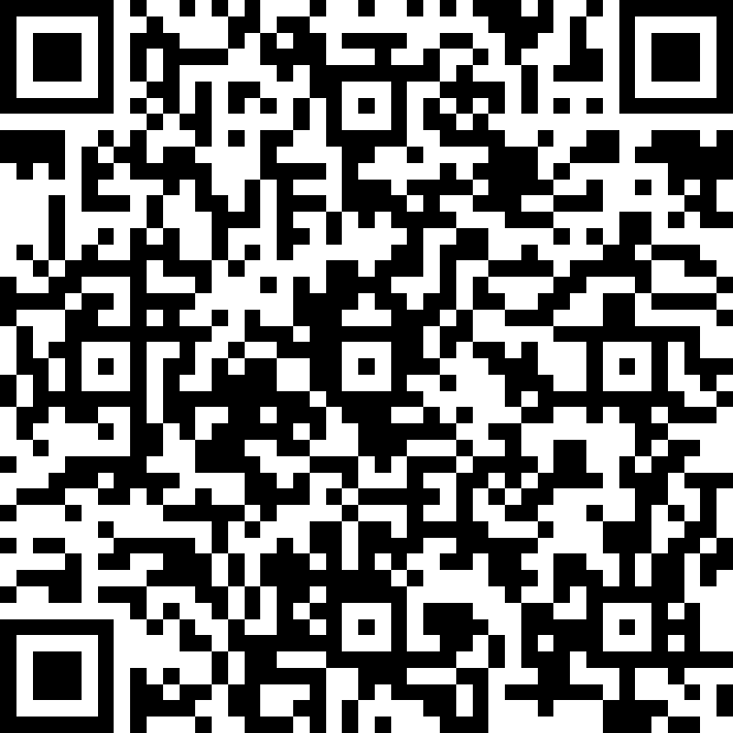
Next Steps?
Make sure you pay attention to deadlines.
Students and Parents carefully look at Course Planning Book, Graduation and Post-Secondary Requirements
You will input your courses yourself via the MyEd Portal. Please use QR Code to access the Course Planning Website and course sheets. COURSES DUE TO BE INPUT BY March 4!!
Consult with Counsellor, Career Facilitator, Websites for more information. SIGN UP ONLINE FOR A VIRUTAL OR IN PERSON APPOINTMENT WITH YOUR COUNSELLOR IF YOU NEED HELP
Minimal Changes can be made until May
Course Verifications handed out in June
Once you have entered your courses into MyEd, any changes after March 4 will have to be through your counsellor.
Please use QR code

Slide 44
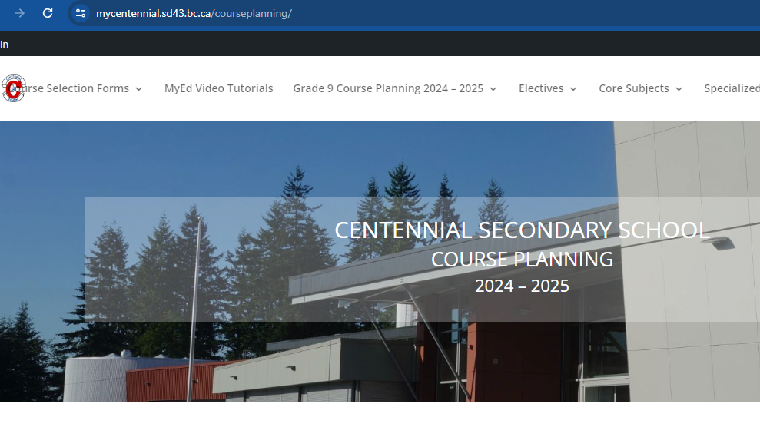

Slide 45
Remember
Academic Rigour/Achievement
Community Involvement
Leadership Activities
Students need to check deadlines and procedures for applications.
Keep up to date on Post-Secondary requirements.
BALANCE! Make sure to take a manageable load of academics and elective courses for highest level of success.

Slide 46
Questions? Please email your counsellor
Maria Thomas (A-Ha) mthomas@sd43.bc.ca
Nina Norlin (He-O) nnorlin@sd43.bc.ca
Denise Healey Wright dhealeywright@sd43.bc.ca
Anita Do (P-Z) ado@sd43.bc.ca

Slide 47
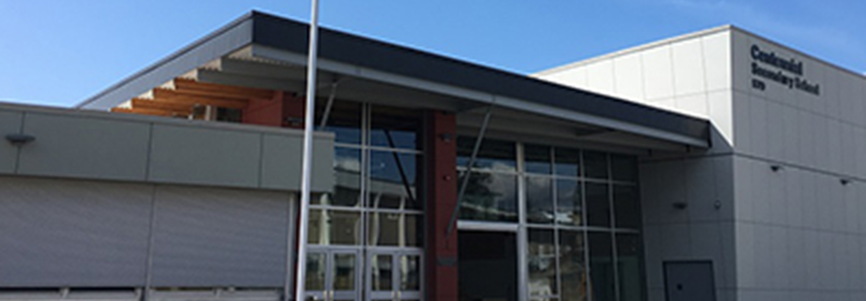
GOOD LUCK NEXT YEAR!

