Slide 1
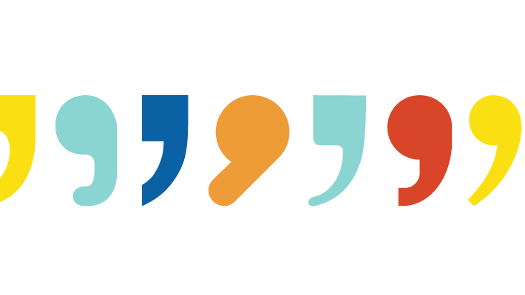
Commas
By: Madisyn, Donya & Brandon

Slide 2
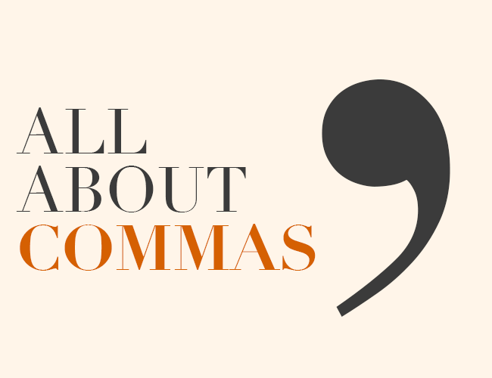
What is the purpose of a comma?
Generally, the purpose of a comma is to separate two (or more) independent clauses joined by coordinating conjunctions.
Let us elaborate.
The coordinating conjunctions are known as connecting words and their purpose is to join two similarly constructed words, phrases, or clauses within a sentence.
For example: and, but, for, nor, so and yet are all coordinating conjunctions.
An independent clause is a clause that can stand by itself as a simple sentence.
For example: "I enjoy sitting at the fireplace and reading.”

Slide 3
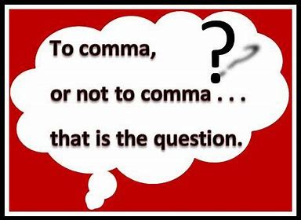
Where would a comma be used?
There’s a large variety of different places a comma could/would be used. For example,
To separate items in a list
For example: “We want chips, juice, cookies and soda.”
Before a quotation
For example: She said, “I want cake.”
After an intro word or phrase
For example: However, he did want her hand in marriage.
And lots more!

Slide 4
What are the rules of a comma?
What to do
What not to do
- When using numbers, put a comma after every third number.
For example: Out of 300,879,621 people...
- Always separate information that is not important to the sentence with a comma or comma(s).
- When addressing someone directly, always separate their name with a comma
- When mixing numbers with commas, don’t include one if it is a page number, date, or street address.
- Don't put a comma after a date if it's used as an adjective
- After using a semicolon, you don’t have to place a comma when you have a transitional conjunction
Note: "transitional conjunctions are words or phrases that indicate the relationship between two sentences or paragraphs." - ediaa.com

Slide 5
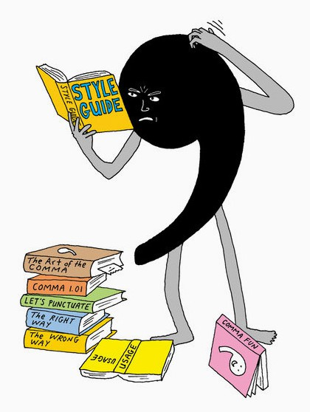
What are the different types of commas? Pg.1
Serial:
A serial comma is the comma you would use when writing a list.
For example: cake, butter and flowers. It is also known/ reffered to as the Oxford comma and/or Harvard comma!!
Introductory:
An introductory comma would be used after a dependent introductory phrase or clause.
For example: Completely oblivious to the rain, the children continued to play outside.
Interrupter:
Used to show emotions, tone etc. in the middle of a sentence. Also used to separate the main sentence.
For example: My sister, to be honest, didn't do her research.

Slide 6
What are the different types of commas? Pg.2
Coordinating:
Coordinate Commas are used to connect two independent sentences. In most cases, this comma can be replaced by the conjunction "and."
For example: I do not know what he said, I do not care.
Subordinate:
Subordinate Commas are used to connect two clauses.
For example: Upon arrival, they had all gone to their rooms.
Free events:
Free Events Commas are used to isolate additional information in a sentence.
For example: My sister, Diane, works at a law firm.
Omissions:
When omitting parts of a sentence, you must add a comma to represent where the omission took place.
For example: During the spring, I go to the gym every day.

Slide 7
Citations!!
When to Use a Comma: 10 Rules and Examples (dailywritingtips.com)
Dictionary.com | Meanings and Definitions of Words at Dictionary.com
Comma Rules: A Simple Guide to Proper Use (yourdictionary.com)
https://owl.purdue.edu/owl/general_writing/punctuation/commas/extended_rules_for_commass.
What are the Rules for Commas? | Basic English Grammar (basic-english-grammar.com)
Comma Rules: 45 Dos and Don'ts of Comma Usage - Part 1 - Professional Writing (magoosh.com)
www.grammarly.com.www.lifehacker.com.au
www.wattpad.com
www.okanagan.bc.ca
www.dailywritingtips.com
blog.hubspot.com
www.cu-Portland.edu
grammar.yourdictionary.com
pediaa.com/what-is-the-difference-between-conjunctions-and-transitions/
https://www.lifepersona.com/

