Slide 1
Innovation Station Industrial Revolution Project
By: Dylan Diasnes

Slide 2
Purpose of my Innovation
THE PURPOSE OF THE INNOVATION I CHOSE WAS TO MAKE WATER TRANSPORTATION FASTER, IT WAS BY CARRYING SUPPLIES, RESOURCES, MATERIALS AND EVEN PEOPLE ACROSS WATER.

Slide 3
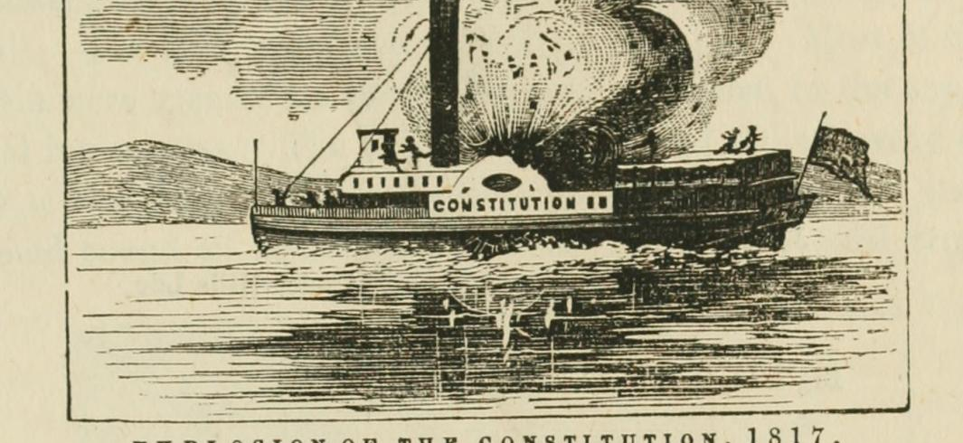
A Problem my Innovation Has Faced Since Creation
A PROBLEM MY INNOVATION HAS FACED SINCE CREATION IS BOILER EXPLOSIONS, THIS WAS CAUSED BY THE DESIGN AND MATERIALS USED IN THE MAKING OF THE BOILER. THE CONSEQUENCE OF THEM NOT IMPROVING THESE IS THAT THE SULTANA EXPLODED IN 1865 AND IS THE WORST MARITIME DISASTER IN U.S. HISTORY.

Slide 4
Consequences of These Problems
WATER POLLUTION CAUSED BY COAL LEAKING OUT OF THE SHIP INTO OCEANS, LAKES AND RIVERS.
AIR POLLUTION CAUSED BY THE COAL BURNING INTO STEAM AND CONTAMINATING OUR AIR.
DESTROYING ECOSYSTEMS SUCH AS ESTRUARIES, WETLAND AND LAKES. THIS WAS ALSO CASUED BY COAL LEAKING INTO THE WATER

Slide 5
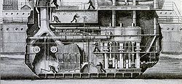
Solutions That Have Been Utilized To Take The Innovation To Where It Is Today
IN ORDER TO TAKE THE STEAMBOAT TO WHERE IT IS TODAY, THEY WERE ABLE TO INCREASE ITS PISTON SPEED AND HENCE ITS HORSEPOWER FOR ANY CYLINDER SIZE. IN PRESENT DAY , THE STEAMBOAT IS ONLY USED FOR CROSSING RIVERS, LAKES AND GIVING COMMERCIAL TOURS.

Slide 6
How do The Current Solutions Help The Innovation Function
THE CURRENT SOLUTIONS HELP THE INNOVATION FUNCTION BECAUSE BY INCREASING PISTON SPEED AND HENCING HORSEPOWER IT HAS MADE THE INNOVATION MORE DURABLE, EFFICIENT AND USEFUL.

Slide 7
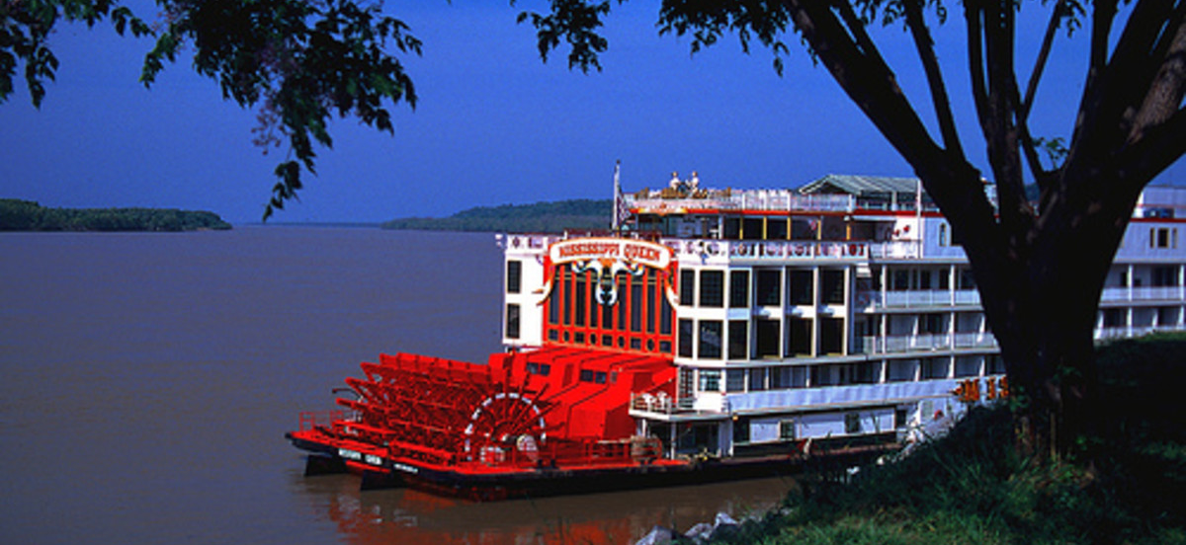
What Does The Innovation Look Like In The Future
IN THE FUTURE, THEY SHOULD USE METALS SUCH AS TITANIUM SO THAT THE SHIP DOESN’T DETERIORATE, THEY SHOULD MAINTAIN A CLEAN HEAT EXCHANGER FOR A MORE EFFICIENT BOILER AND FINALLY THEY SHOULD CHANGE THE ENERGY SOURCE TO ‘SOLAR POWER’ SO THAT SHIPS ARE NOT POLLUTING OUR AIR AND WATER

Slide 8
How Does It Work? Why Is It Better?
IT FUNCTIONS MORE EFFICIENTLY. IT IS BETTER BECAUSE A CLEANER HEAT EXCHANGER WILL ALLOW A MAXIMUM HEAT TRANSFER FROM THE BURNING FUEL TO THE BOILER WATER, BETTER METALS WILL INCREASE THE LONGGEVITY OF THE SHIP AND MAKE IT RECYCLABLE AND FINALLY SOLAR POWER AS THE ENERGY SOURCE WILL MAKE THE SHIP ENVIRONMENTLY FRIENDLY.

Slide 9
What Are The Positive Consequences Of My Solution? How Does It Better Serve Our World?
POSITIVE CONSEQUENCES: MAXIMUM HEAT EXCHANGE, LAST LONGER, ECO FRIENDLY, LESS MONEY SPENT ON MATERIALS
IT BETTER SERVES OUR WORLD BECAUSE THERE WON’T BE WASTED HEAT, THE SHIP WON’T NEED REPAIRS, IT IS RECYCLABLE, IT DOESN’T RUST AND IT IS ECO FRIENDLY.

Slide 10
My Improvements
Place solar panels on the front so that the power source is solar instead of coal. Coal can cause water pollution, air pollution and can hurt ecosystems
Make sure they maintain a clean heat exchanger inside of the ship so that the boiler is more efficient and reliable.
Use titanium as the outside layer opposed to wood/weak, unreliable metals. I would do this so that the outside layer wouldn’t deteriorate/rust.

Slide 11
Bibliography
Picture 1
https://history.nebraska.gov/sites/history.nebraska.gov/files/wp-content/uploads/2014/03/Wrecked-steamboat-from-Chittenden-RG2593.PH0-5873.jpg
Picture 2
https://slate.com/human-interest/2015/03/history-of-steamboats-on-the-mississippi-lloyd-s-directory-of-disasters.html
Picture 3
https://unsplash.com/s/photos/steamboat
Picture 4
https://en.wikipedia.org/wiki/Marine_steam_engine

Slide 12
Bibliography
Picture 5
https://untappedcities.com/2016/08/17/today-in-nyc-history-robert-fultons-revolutionary-steamboat-makes-its-first-run/
Picture 6
https://thedailybanter.com/2009/07/31/gop-looks-to-the-future-with-steamboats/
Picture 7
http://www.neworleansrestaurants.com/news/restaurant-reviews/christmas-and-new-years-eves-aboard-the-steamboat-natchez
Picture 8
https://www.getyourguide.com/new-orleans-l370/new-orleans-day-cruise-aboard-the-steamboat-natchez-t22810/
Picture 9
https://www.sutori.com/item/1807-robert-fulton-added-a-steam-engine-to-the-ship-clermont-this-invention-b
Research
http://44610566.weebly.com/negative-impacts.html
https://prezi.com/aqmxln4poeat/the-industrial-revolution-innovations-the-steamboat/
https://itstillruns.com/disadvantages-1800s-steamboats-8540290.html

