Slide 1
New France
By Isabelle Ghioda

Slide 2
Settlement of New France
In the early 1600s, French settlers started a colony in the New World. They did this to ensure that France would have a share in the profitable fur trade, and that missionaries could be sent to convert the Aboriginal peoples to Christianity.

Slide 3
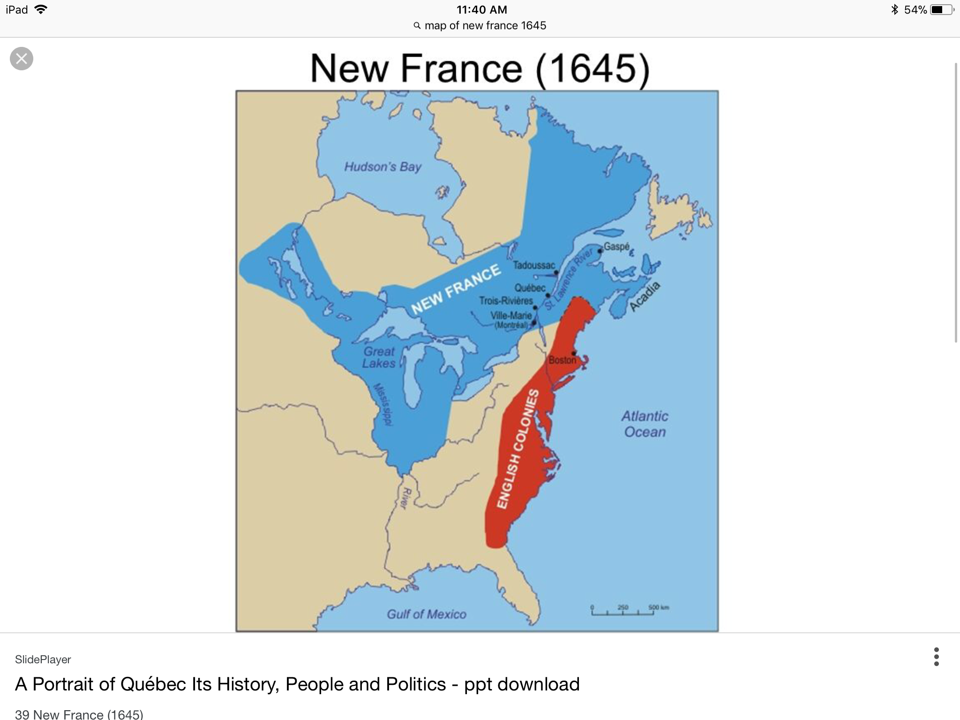
New France in 1645

Slide 4
Why was New France created? New France was created to provide riches and power to its parent country, France. The King of France was at the top of New France hierarchy, even though he never visited the colony.

Slide 5
What was Frances main motivation for starting the colony of New France?
Frances main motivation for starting the colony of New France was to accumulate more wealth.

Slide 6
What did New France export to other French colonies?
New France exported fur, fish and water to France and other French colonies.

Slide 7
New France was ruled by the King of France. No King ever visited the colony, but the governor permanently resided there and represented him. The governor commanded soldiers, dealt with other colonies and Aboriginal Nations, and otherwise behaved like royalty.
The Governor

Slide 8
The intendent
The Intendent was positioned below the governor, yet reported directly to the King. His duties involved the financial, legal, and economic concerns of the colony. The intendent and governor were a part of the sovereign council, which made laws and set taxes for the colony’s citizens.

Slide 9
The Bishop
Although the bishop was an official of the church, he held an important position in the sovereign council. His responsibilities included overseeing the hospitals, schools, missions, and churches.

Slide 10
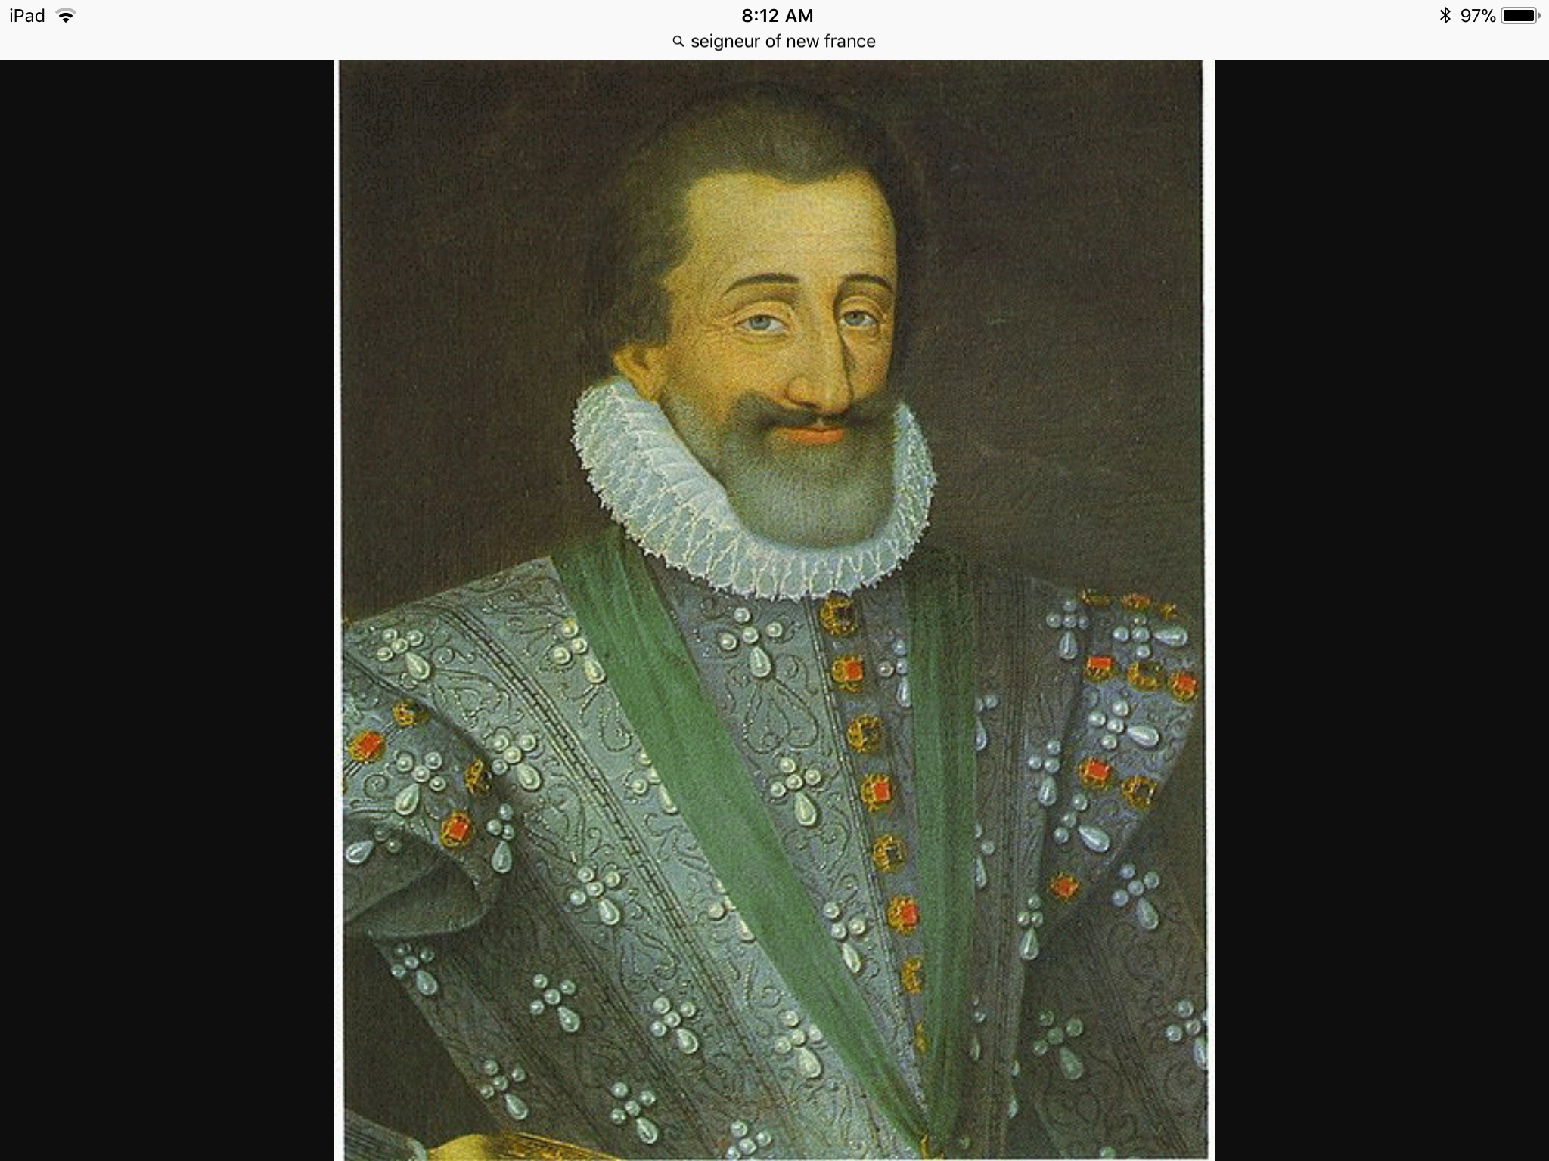
Rural New France operated using a seigneurial system. The seigneur, usually a man of nobility, owned land on which the habitants lived and worked. He also had responsibilities to the habitants.

Slide 11
Seigneur Jobs
-build their own manors
-resolve conflicts with the seignuerie
Defend the seignuerie from outside attack
Build mills
Attract settlers

Slide 12
Habitants Job
serve in the militia
Grind grain into flour
Provide free labour to build a church
Pay rent
Work the land

Slide 13
How the fur trade ignited
The fur trade ignited cooperation between the French and First Nations peoples. However, it increased competition for global power between the French and the British.

Slide 14
What was New France’s first line of defence from Britain?
At the entrance of the St Lawrence River, Louisbourg was surrounded by thick walls. This fortress was New France’s first line of defence from British ships wanting entrance.

Slide 15
How did the Seven Years War begin?
The capture of Louisbourg by the British marked the begging of the seven years war in North America.

Slide 16
Where did the final battle between the French and British take place?
The final battle between the French and the British on North American soil took place on the plains of Abraham, a field near the city of Quebec.

Slide 17
How the seven years war ended
The seven years war ended with the warring nations sighting a treaty.

