Slide 1
The Typewriter
Jada M

Slide 2
The Purpose
In 1867 Christopher Latham Sholes invented the first practical typewriter, the invention helped writers get work done faster. The typewriter benifeted the Industrial revolution by preventing hard to read hand written manuels for workers and could spread news faster.

Slide 3
Problems
Although the invention of the typewriter was a faster way to get things written down opposed to handwriting, typing too fast would cause jams.
The placement of the keys was apart of the problem so later Sholes decided to rearrange the placement of the keys, so instead of alphabetical order, he moved the most commonly used letters farther apart.

Slide 4
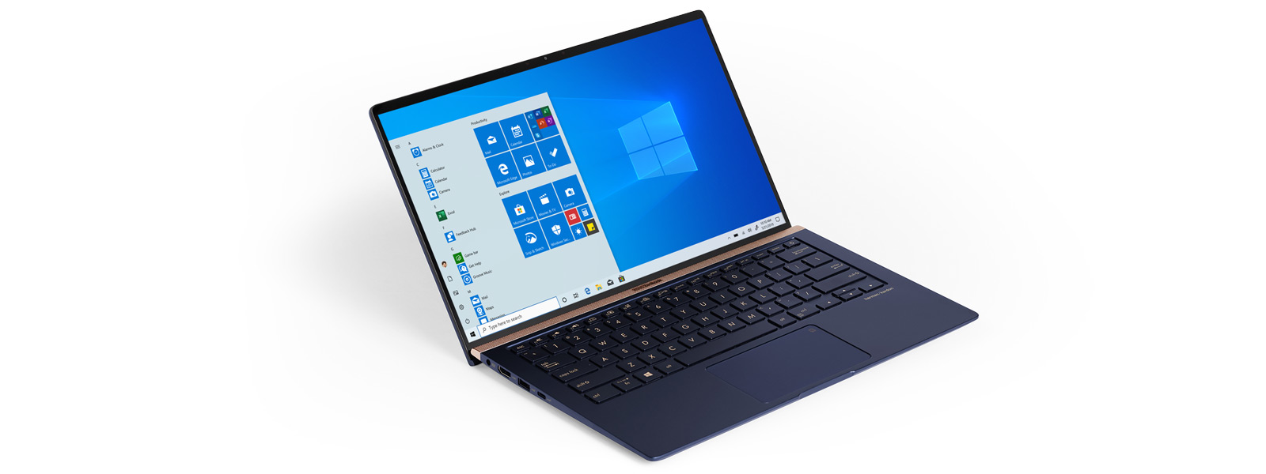
Problem and Solution
Problem
Solution
Another problem that occurred after the invention after the invention of the typewriter was part of the design, whatever you typed printed right away as there was no screen. This meant no spelling checks and if you made a mistake you wouldn't be able to fix it or you would have to restart which led to wasted paper.
Unlike the typewriter, the computer has a screen where everything you type comes up which allows you to see your work so you can edit mistakes.

Slide 5
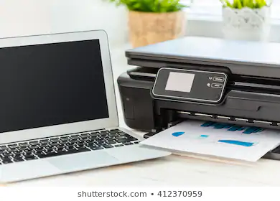
Positives and Negatives
Positive
Negative
Able to edit mistakes before printing
With the invention of the computer came emails so you can so you wouldn’t need to waste paper by printing to send letters
You'd have to buy a printer sepratley if you're planning on printing at home

Slide 6
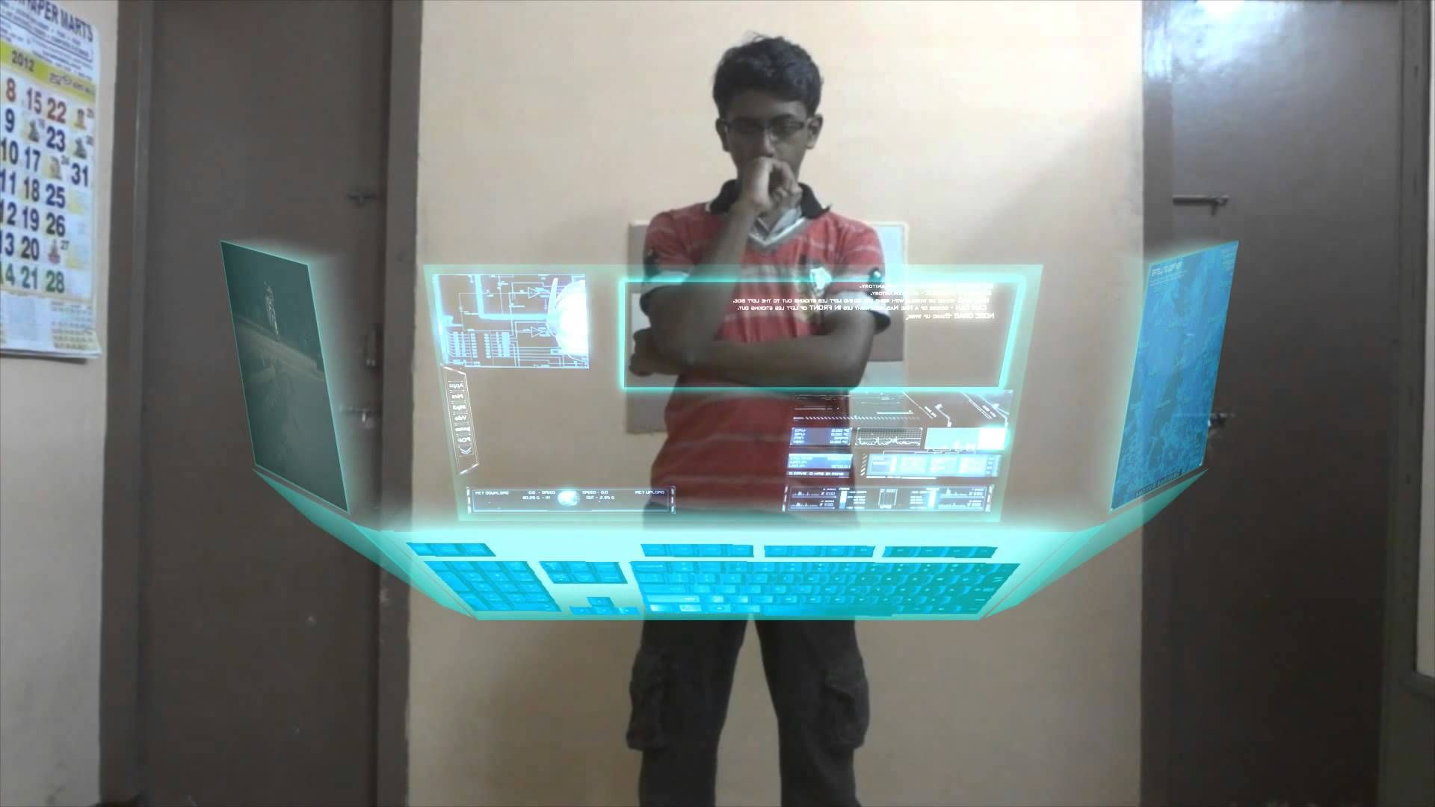
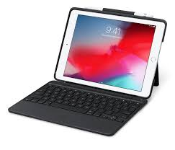
The Future
Since we already have touchscreens, voice activation, portable computers, and detachable keyboards it's hard to think of anymore improvements, but of course we're going to try and go farther and bigger with the invention. For example maybe in the future instead of a screen we'll have a hologram and, even though it sounds impossible, we control it with our minds instead of a mouse.

Slide 7
The Future
Although being able to control things with your mind sounds awesome, theres a lot of things that could go wrong with it, it would encourage people to be even lazier, but at the same time it would get things done even faster.

Slide 8
Bibliography
Bigler, Jeff. “Early Typewriter History.” Early Typewriter History, 16 July 2001, www.mit.edu/~jcb/Dvorak/history.html.
The Editors of Encyclopaedia Britannica. “Typewriter.” Encyclopædia Britannica, Encyclopædia Britannica, Inc., 13 Feb. 2018, www.britannica.com/technology/typewriter.
“Typewriter History.” MyTypewriter.com - Your Source of Classic Typewriters, Supplies, Accessories and Information., 2006, mytypewriter.com/explorelearn/

Slide 9
Photo Bibliography
Apple Inc. “Detachable Keyboard for IPad.” Apple, 2020, www.apple.com/shop/product/HMBF2VC/A/logitech-slim-combo-with-detachable-keyboard-for-ipad-6th-5th-generation?fnode=e3d13f530380ae21427c5780e743530bd53e5484926d552809d6a4ea5101bcfb625fbc5f1cc0db89b27127298dd61a28566303d6754a8d4c5831e24ad68055b857b6eafbccf2d02072ac7214122abc0b7b92c5866834d06bfc0626cdf19bdf1c.
Burgess, Brian. “Computer Printer.” Groovy Post, 23 July 2019, <img src="https://www.groovypost.com/wp-content/uploads/2019/02/laptop-printer-featured.jpg" alt="Windows 7: Share a Printer Between Two Computers"/>.
Encyclopædia Britannica. “Remington Typewriter.” Encyclopædia Britannica, 13 Feb. 2018, www.britannica.com/technology/typewriter#/media/1/611749/210840.
Klien, Genevieve. “Hologram Computers.” Lifeboat Foundation, 16 Aug. 2018, lifeboat.com/blog.images/hologram-computers-mobiaq-illuminair-holographic-computer-virtual-reality-augmented-virtuality-holography-computer-hologram-virtual-projection-developed-technology-realty-wide-screen-gamin.jpg.
Microsoft Windows. “Windows 10 Laptops.” Microsoft, 2020, www.microsoft.com/en-us/windows/windows-laptops.
Tait, Amelia. “NewStatesman.” NewStatesman, 15 Sept. 2016, www.google.com/url?sa=i&url=https%3A%2F%2Fwww.newstatesman.com%2Fculture%2Ffilm%2F2016%2F09%2Flist-ways-our-society-already-pixar-s-dystopia-wall-e&psig=AOvVaw0VMFRntpEQcw2c33VwiUON&ust=1586312547779000&source=images&cd=vfe&ved=0CAIQjRxqFwoTCPjMq_Kg1egCFQAAAAAdAAAAABAD.

