Slide 1
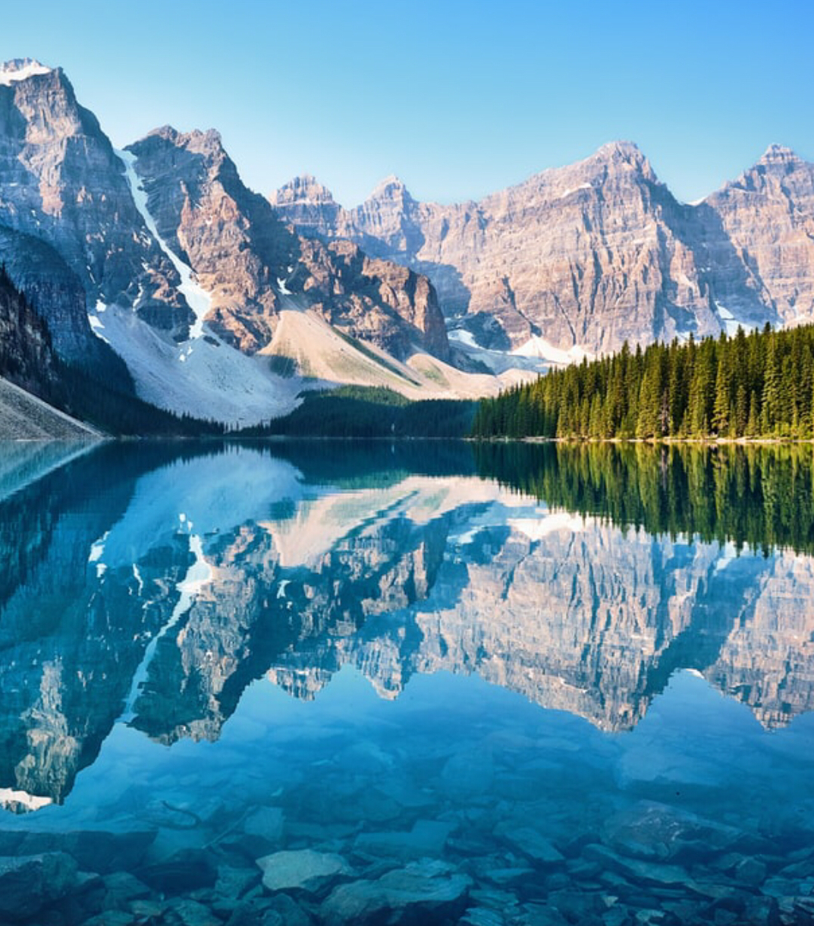
Banff
Justin

Slide 2
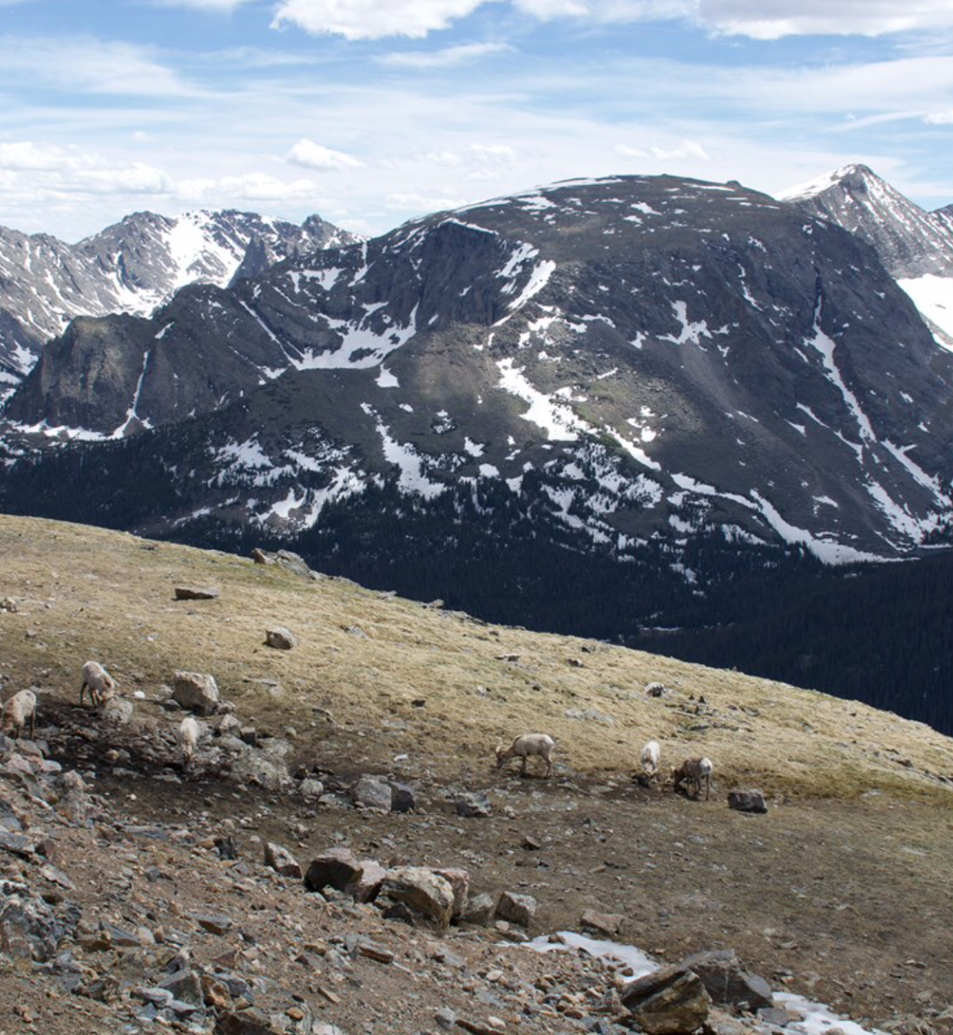
Physical Landforms and Economic Activities
Mountains
- Mountain climbing
- Skiing and Snowboarding
Why mountains exist
- Plates under earth move and push ground up creating mountains
Lakes
- Hiking
- Canoeing
- Fishing
- Swimming
Why lakes exist
- Formed by glaciers
- Glaciers carved out great pits and scrubbed the land as they moved slowly along

Slide 3
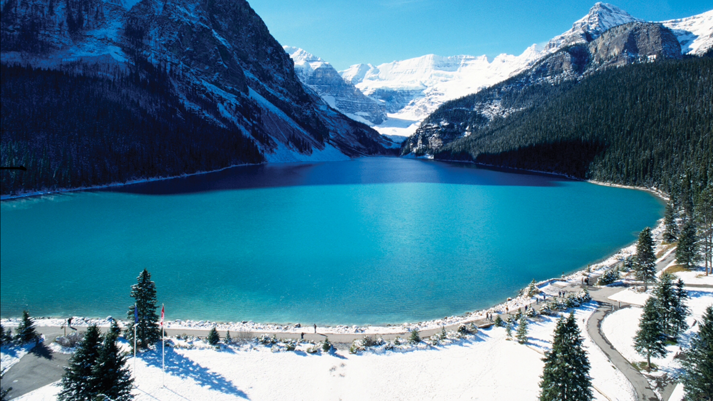
Climate and Economic Activities
Summer
- Low humidity, warm temperatures and long daylight hours
- Average highs are about 21°C and average lows around 7°Come
Economic Activities: Boat tours, Biking, water rafting.
Economic Benefit: Crop growing
Autumn
- Average temperatures dropping, but remains above freezing levels
Winter
- Snow begins to fall on November
- Average temperatures around -12°C
Economic Activities: Snowmobiling, Ice walks,Ice skating, Ice climbing, Cave tours.
Spring
Economic Benefit: Skiing
- Rain and warm temperatures starts to melt the snow. However, snow on the mountains remain until mid-summer

Slide 4
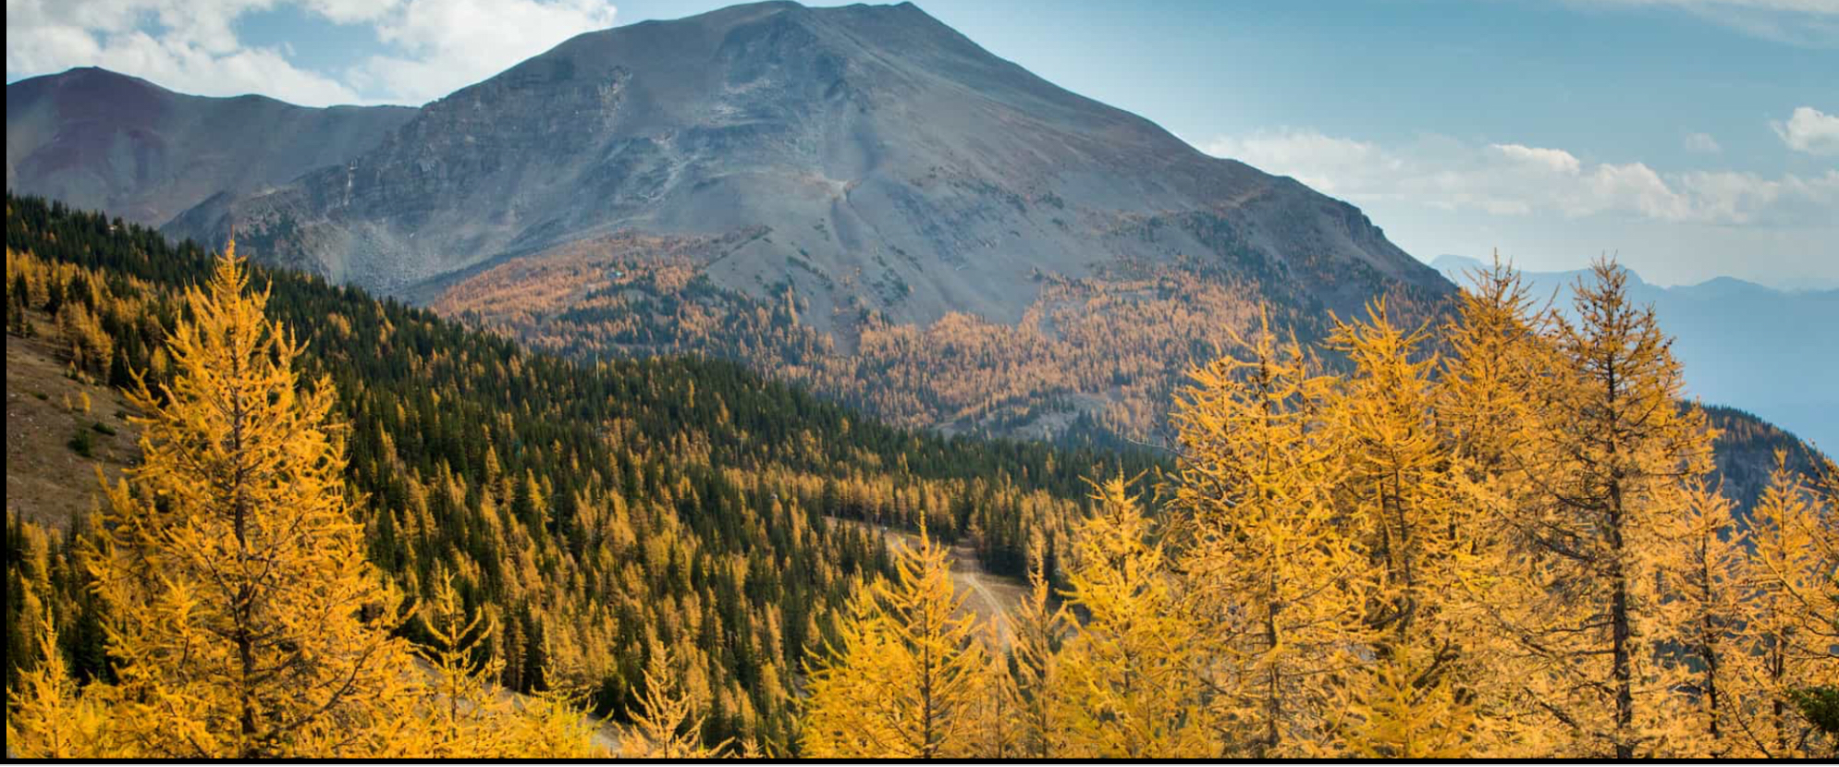
Vegetation and Economic Activities
Montane Zone
- Grassy meadows
- Many types of trees: Douglas fir, White spruce, Trembling aspen, Lodgepole pine.
Economic Activity: Animal watching
Subalpine Zone
- Large, closed coniferous forest
- Englemann spruce, subalpine fir, and Lodgepole pine
Economic Benefits: Harvesting of timber, campgrounds, resorts, cross-country

