Slide 1
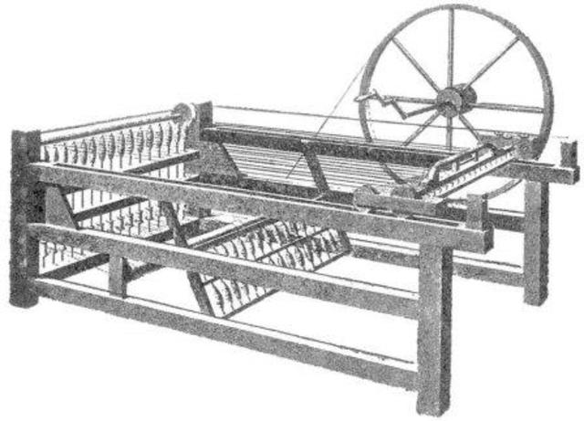
Spinning Jenny
- Invented in 1764
- Invented by James Hargreaves
- Purpose: A machine that can spin up to 8 spindles at once for faster production.

Slide 2
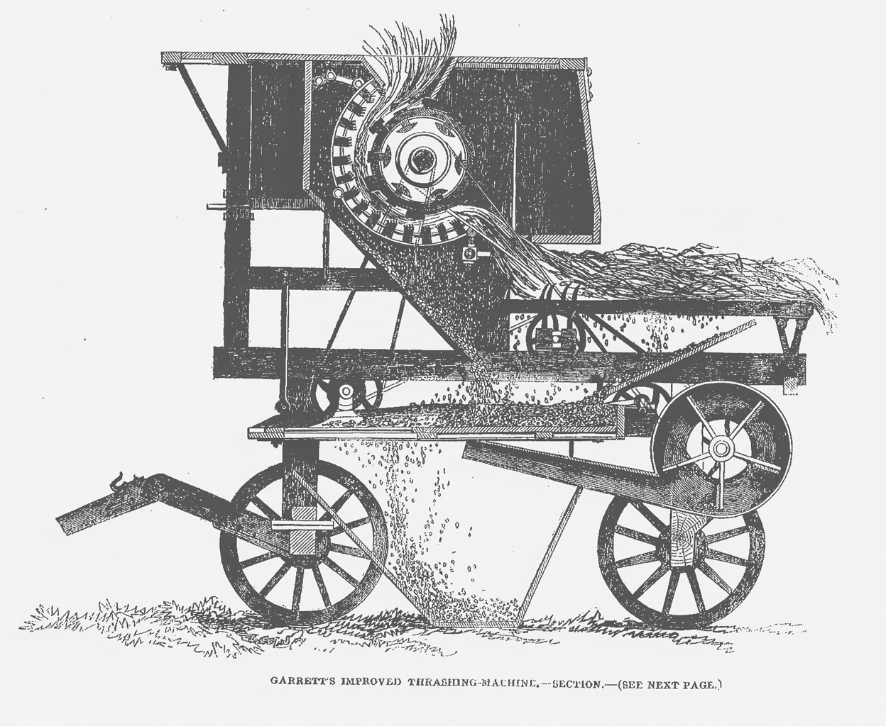
Threshing Machine
- Invented in 1786
- Invented by Andrew Meikle
- Purpose: To separate the grain from the straw and other light materials.

Slide 3
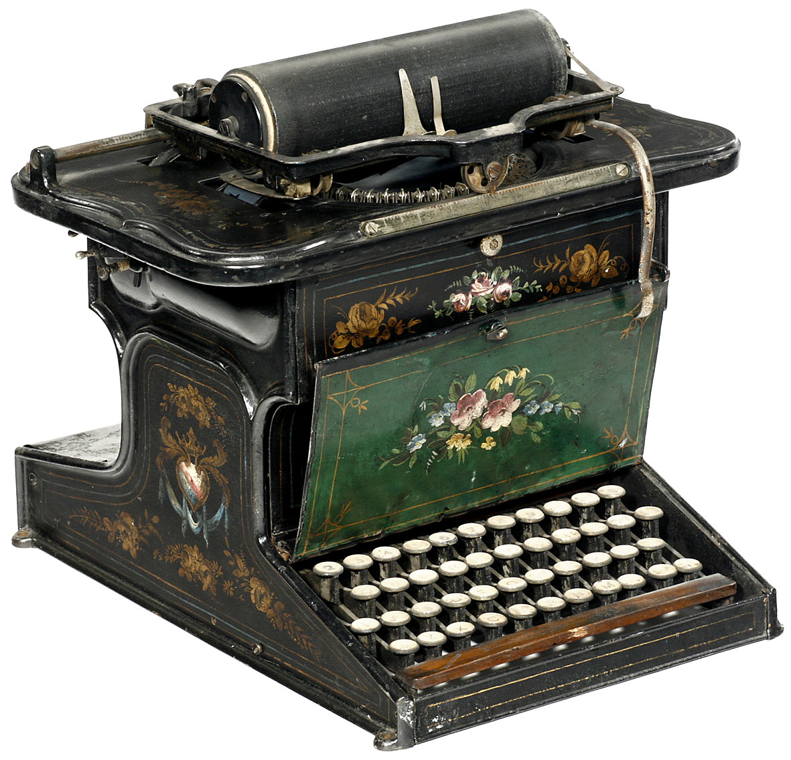
Typewriter
- Invented in 1829
- Invented by William Austin Burt
- Purpose: A mechanical device that puts characters on a piece of paper by pushing the keys.

Slide 4
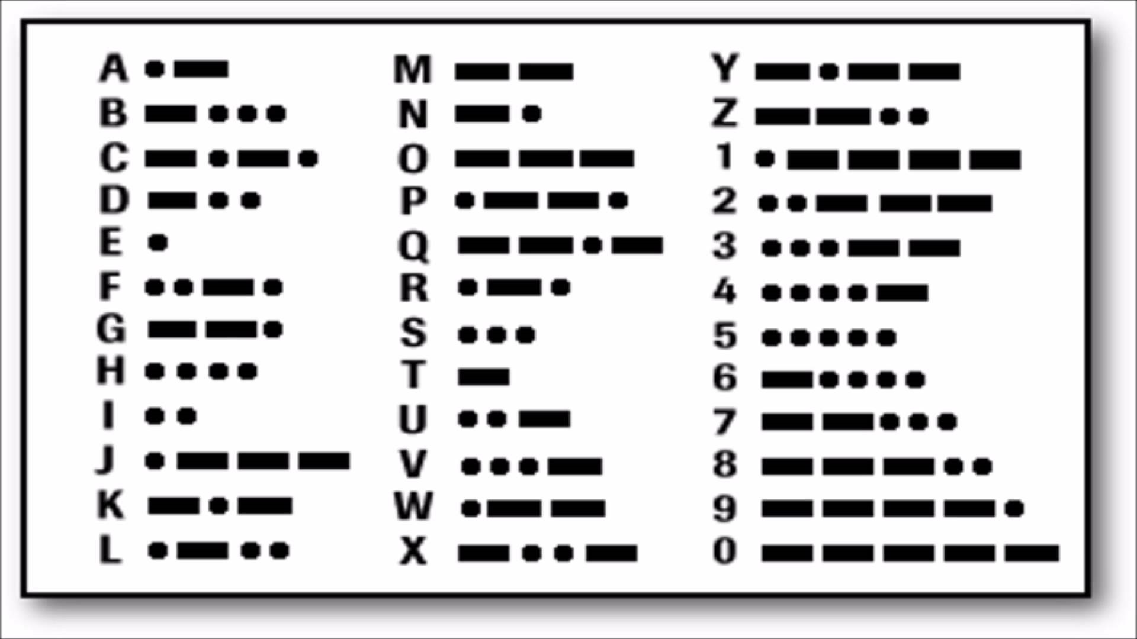
Morse Code
- Invented in 1836
- Invented by Samuel Morse
- Purpose: Detailed system of dots, dashes, and space to represent umbers, letters, and punctuations.

