Slide 1
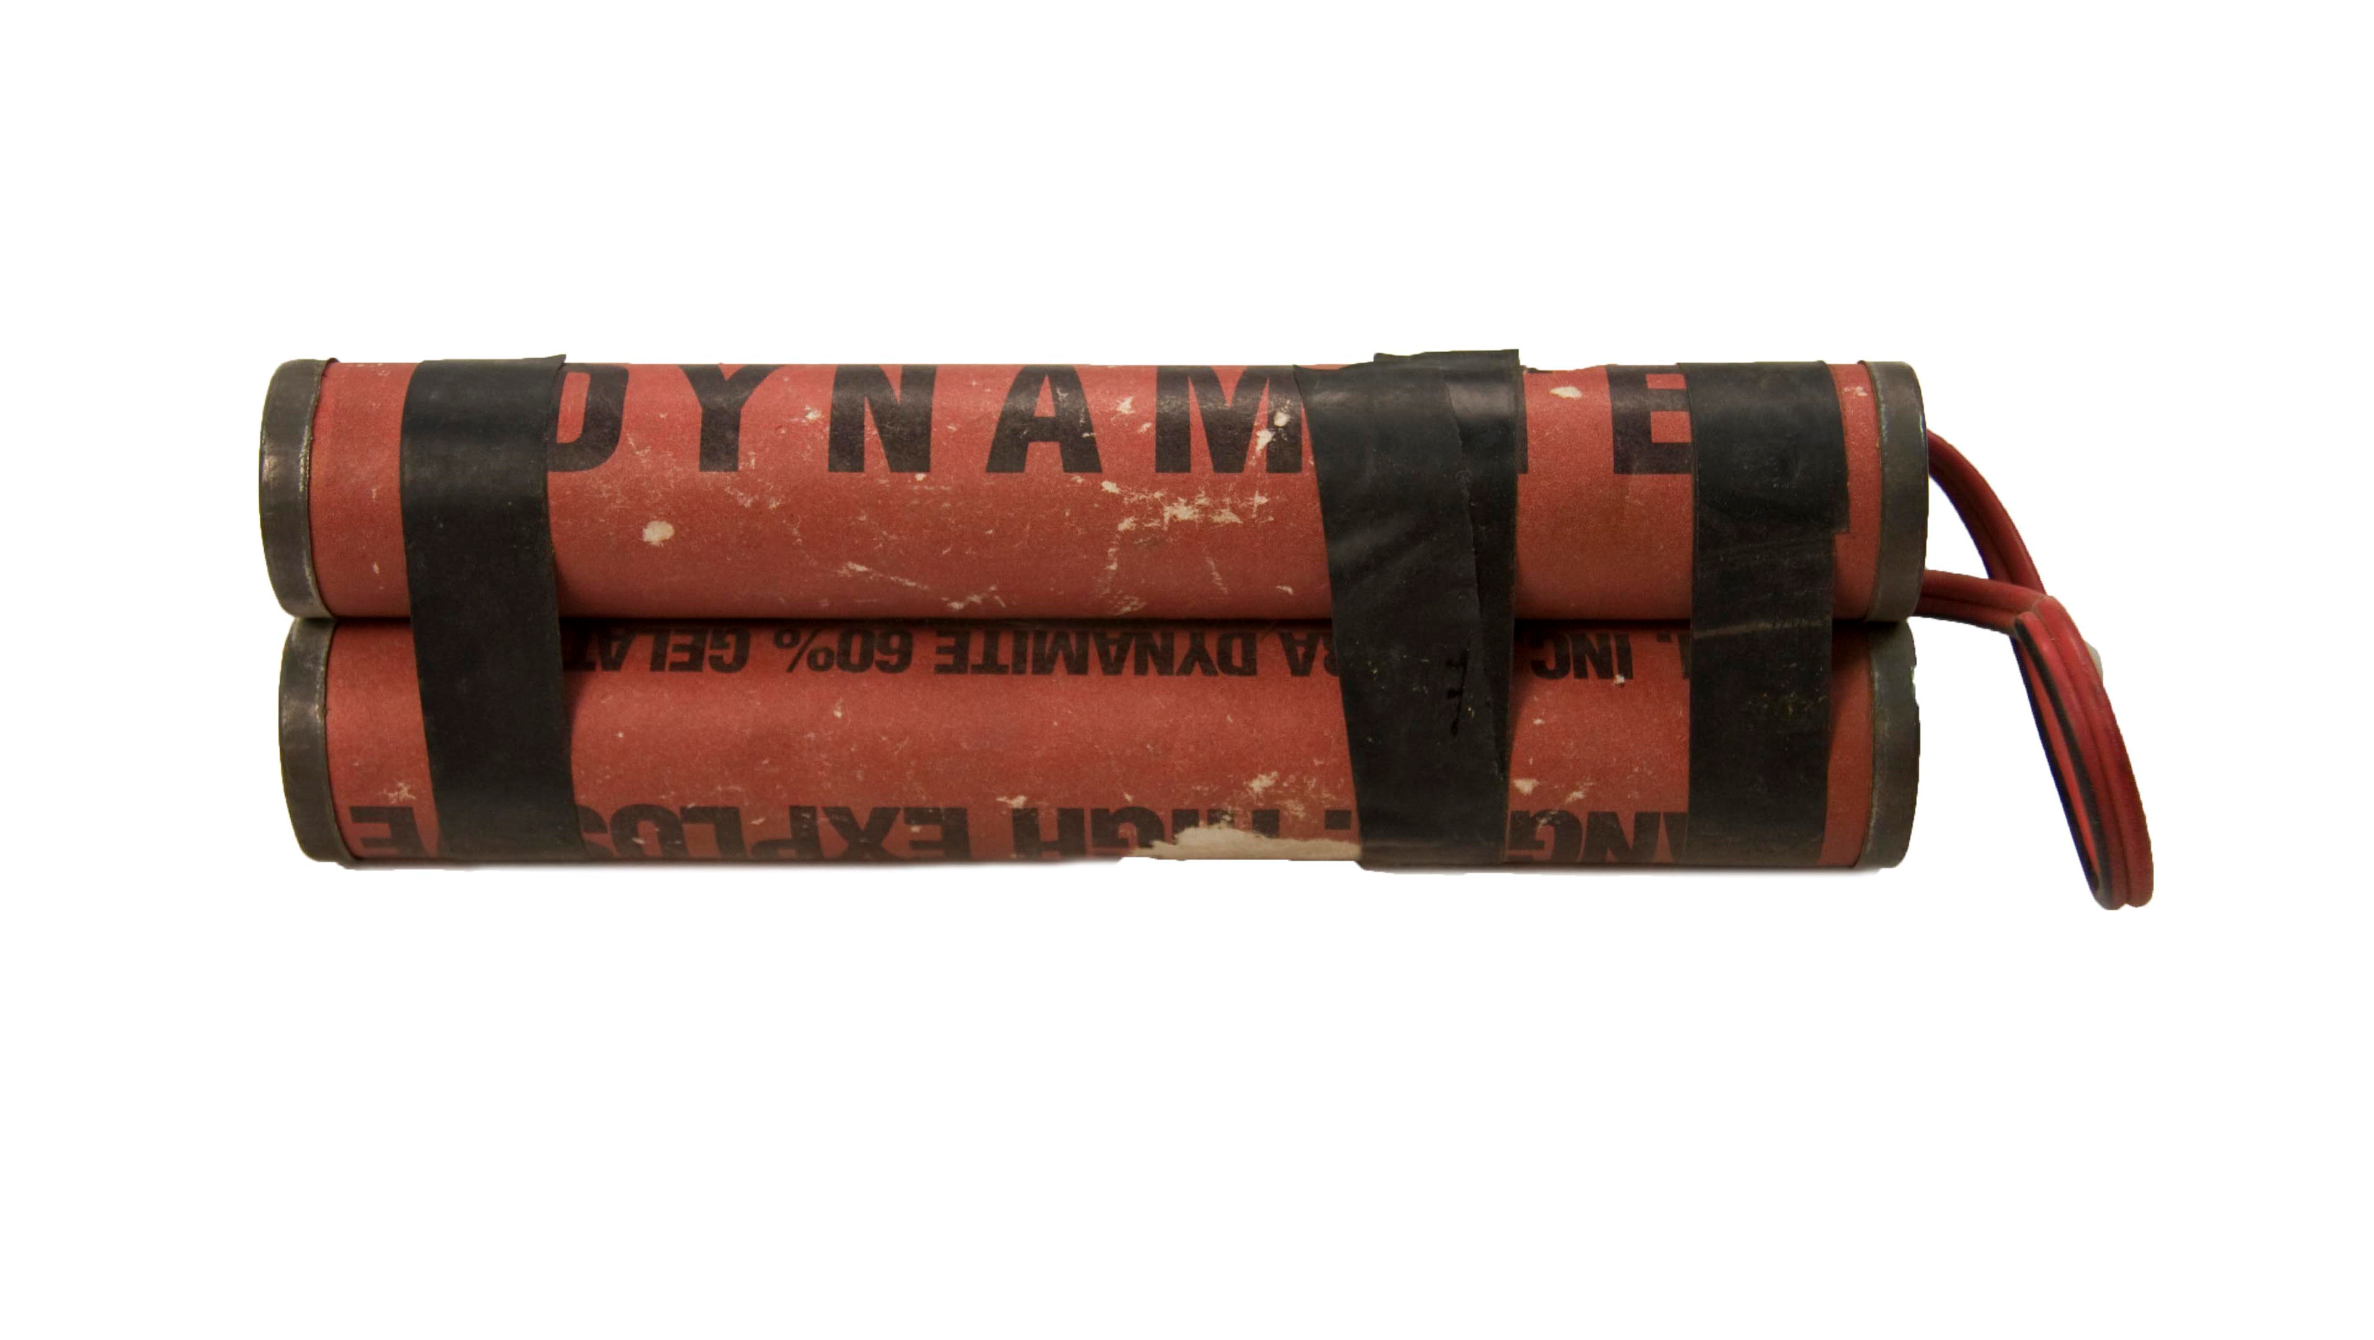
Dynamite
- Invented in 1867
- Invented by Alfred Nobel
- Purpose: Used in mining, quarrying, construction, and demolition.

Slide 2
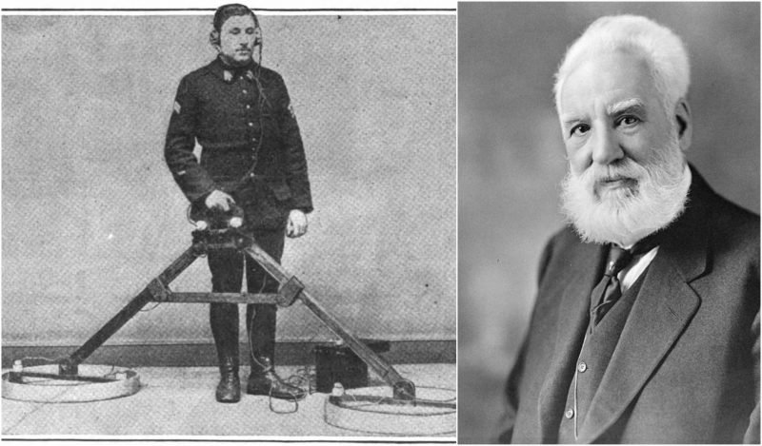
Metal Detector
- Invented in 1881
- Invented by Alexander Graham Bell
- Purpose: Detects nearby metal by using a magnetic field.

Slide 3
Reflection
The Morse code was first invented in 1836 by Samuel Morse and Alfred Vail . Its purpose was to communicate with the Morse code using telegraphs from long distances. As time passed by, the telegraph got more advanced, making it send codes faster and more efficient. The purpose of the telegraphs and the codes remained the same. The advantages of using Morse code is that it is cheap and wireless. The disadvantages are that it is hard to learn, time consuming, and interruption.

Slide 4
Sources
https://www.britannica.com/technology/steam-engine
https://www.thoughtco.com/jethro-tull-seed-drill-1991640
https://www.britannica.com/technology/flying-shuttle
https://www.fi.edu/history-resources/franklins-lightning-rod
https://www.britannica.com/technology/spinning-jenny
https://www.merriam-webster.com/dictionary/threshing%20machine
https://www.britannica.com/technology/typewriter
https://www.britannica.com/topic/Morse-Code
https://www.electronics-notes.com/articles/history/morse-code-telegraph/telegraph-history.php
https://connectusfund.org/5-advantages-and-disadvantages-of-morse-code
https://www.thoughtco.com/history-of-dynamite-1991564
https://www.metaldetector.com/learn/metal-detector-history/history-of-the-metal-detector
https://www.google.ca/ https://www.bing.com/ (images)
http://www.theinventors.org/library/inventors/bl1700s.htm

