Slide 1
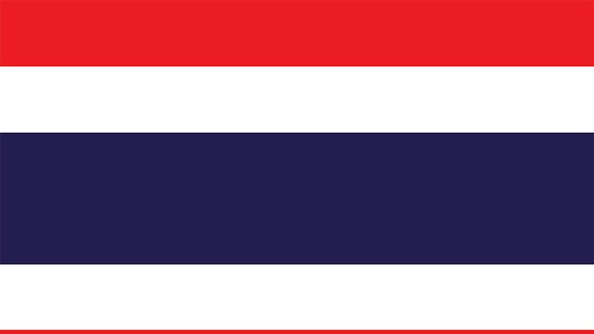
Thailand
Socials Studies 10
Pahlika Suthakaran
Block 5

Slide 2
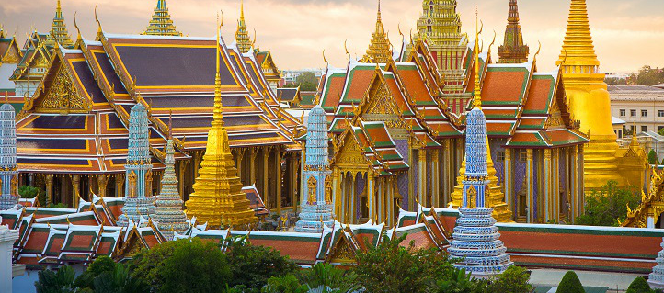
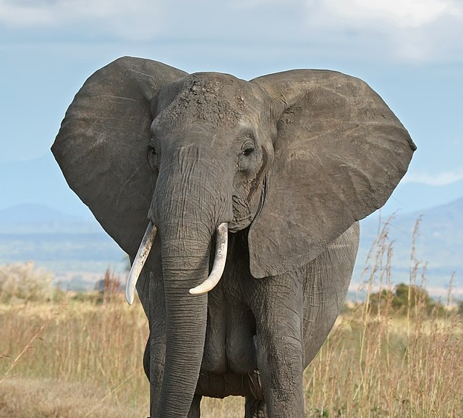
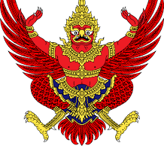
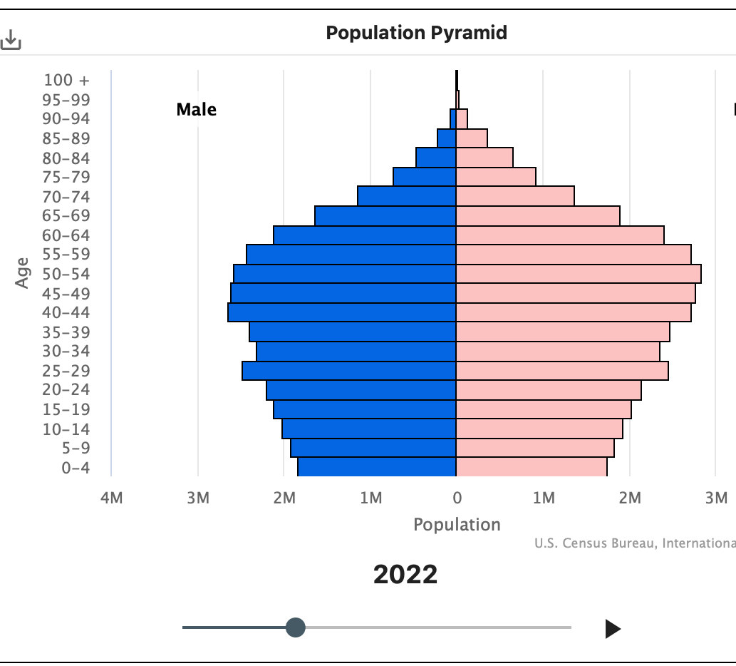
Country Info
Thailand is a Southeast Asian country and is known for its tropical beaches, temples, and royal palaces.
The capital city of Thailand is Bangkok, and the country has 77 provinces.
Thailand's national and royal symbol is the Garuda bird the Mount of Lord Vishnu. It is half man and half bird from, and it originated from both Buddhism and Hinduism.
An animal that represents Thailand would be the elephant because of the important roles it played throughout Thailand's history

Slide 3
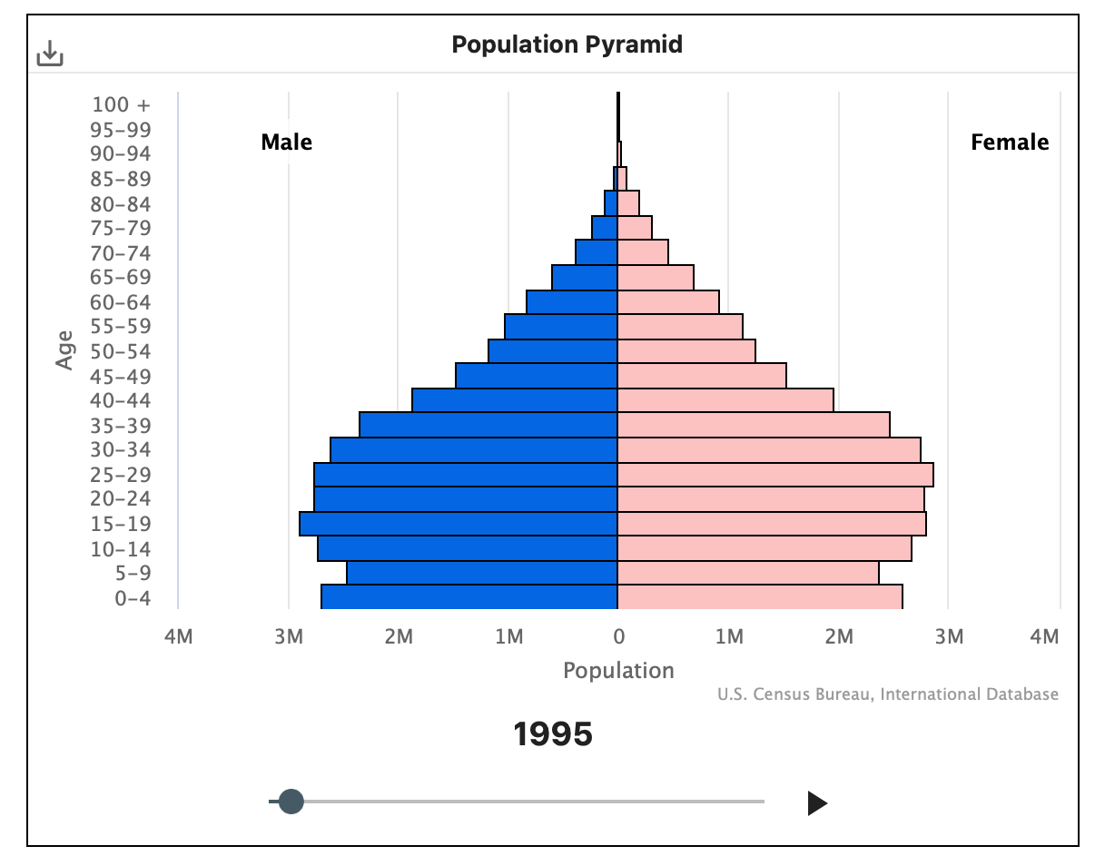
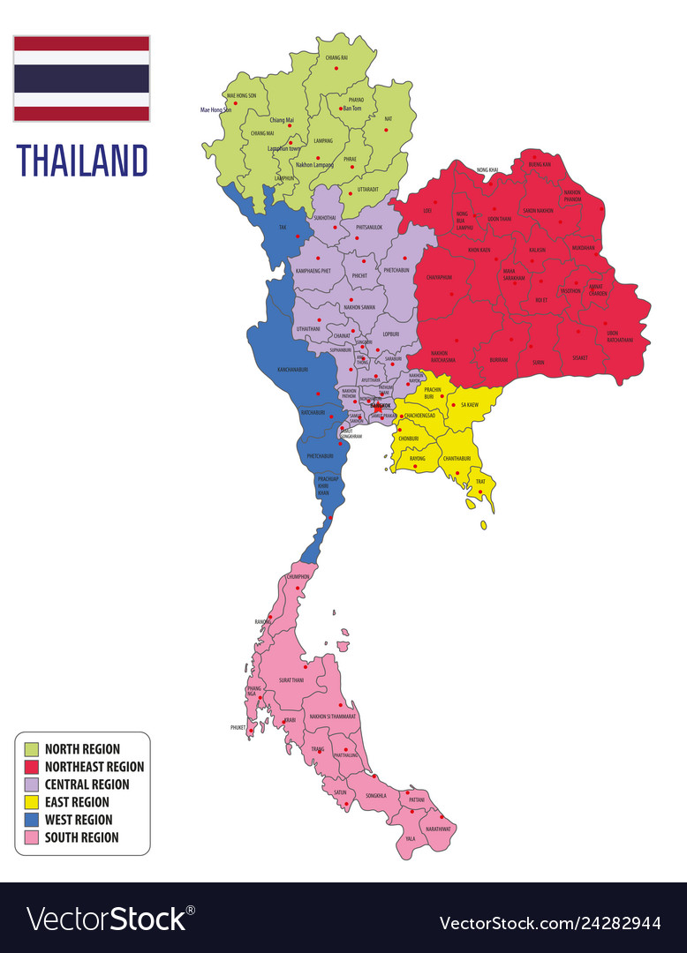
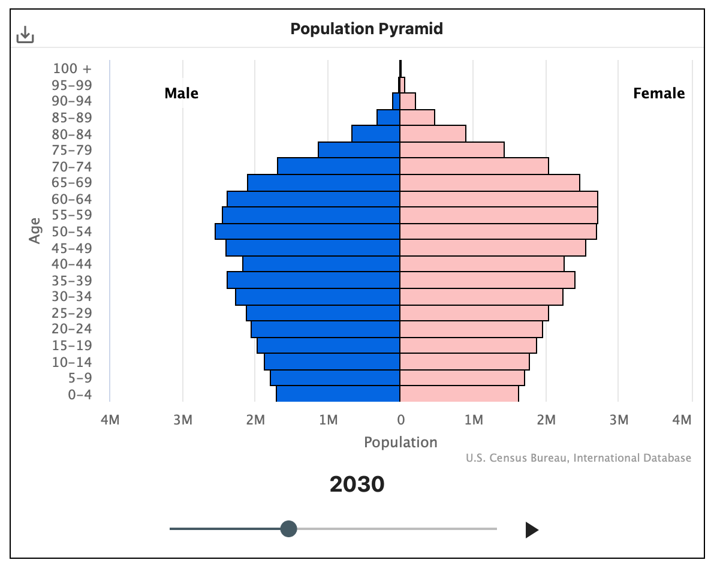
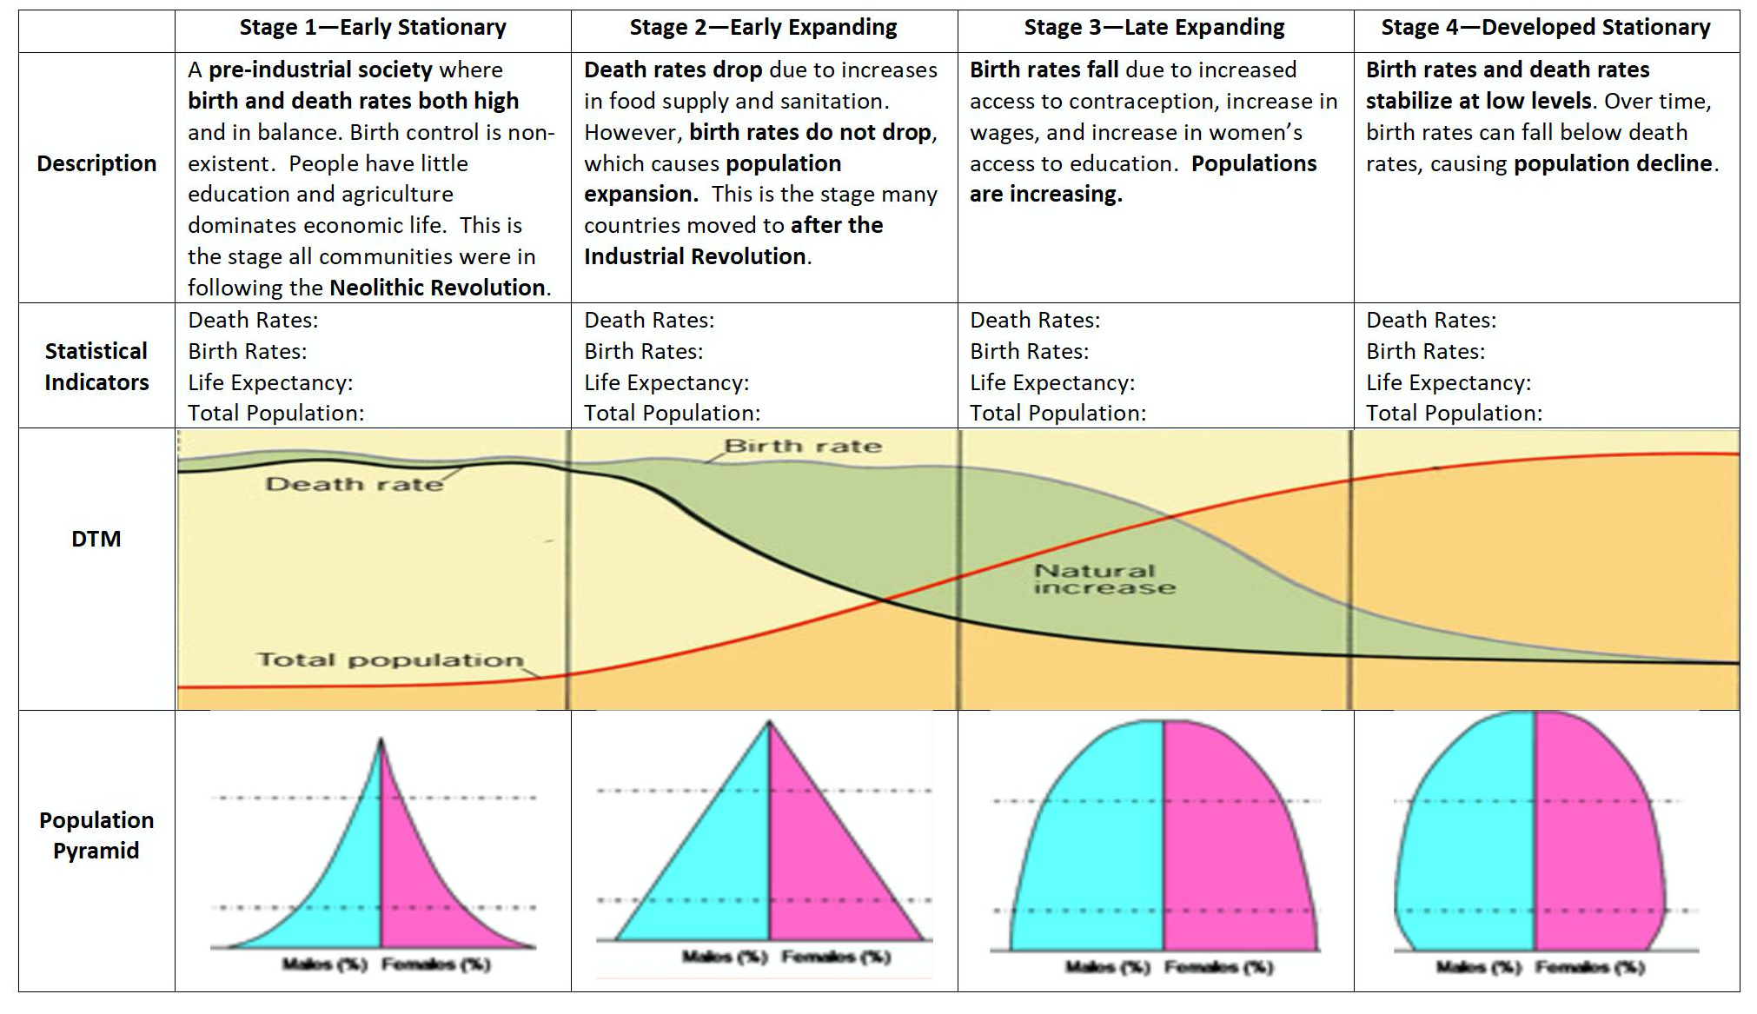
Past and Future
Population 69,648,117 in 2022
Growth rate percent is 0.25%
Life expectancy at birth for males are 74.7 and for females it is 80.8
Under five mortality rate (per 1000) is 8.7
Thailand's population pyramid in 2022 is at stage 3 – Late Expanding
Expanding
Stable

Slide 4
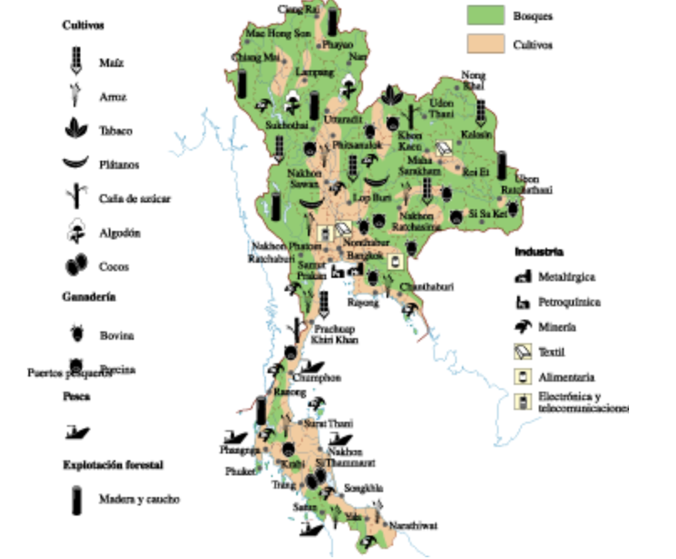
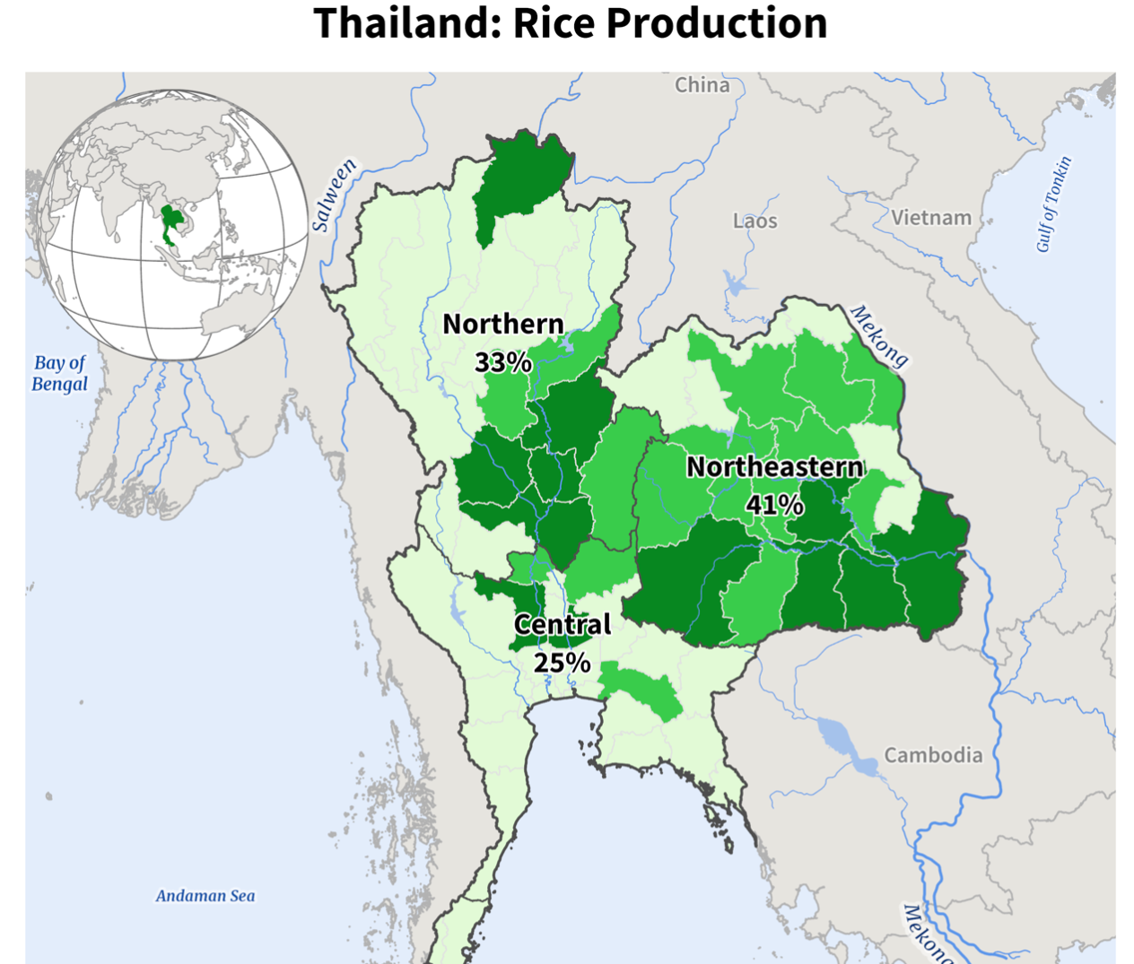
Resource Production
The agricultural production in Thailand consists of rice, cassava, corn, mangoes, pineapples, durians, cashews, and vegetables. Rice is the largest agricultural production in Thailand with 60 percent of 13 million farmers growing it.
Exports: Machinery (16.8%), vehicles(11.9%), Rubber(7.4%), Gems(3.7%), fruits and nuts(2.3%), meat and seafood(2.2%), and rice(6-6.3 million tons this year)
Imports: Petroleum, circuits, gold, iron and steel, copper, and medical apparatuses.
Major crops include sugarcane, cassava, shallots, potatoes, garlic and onions. In 2018 it was reported that Thailand has 32.9 percent arable land.
Between 36 and 41% of total land in Thailand is classified as agricultural, and 28–33% is classified as forestland.

Slide 5
Conclusion Pt.1
Economic issues:
Thailand is a constitutional monarchy, and their economy is at a stage of growth. Thailand is a free-market economy the kingdom has a strong domestic market and a growing middle class, with the private sector being the main engine of growth. The Thai economy is well into the global marketplace, with exports for over 70 percent of the Kingdom's GDP ( Gross Domestic Products). Moving from a low-income to an upper middle-income country in less than a generation.
Urbanization:
Thailand has been a widely cited development success story, with sustained strong growth and impressive poverty reduction. Bangkok is a city that is has become overpopulated and chaotic. In Thailand, the infrastructure for water, sewage and energy are underdeveloped and slowing the rate of urbanization. Smaller cities and rural areas are also suffering because of their inability to attract investors due to poor infrastructure. Thailand's problem with inadequate transportation is so severe that the Bangkok Metro Region has become internationally notorious for its legendary traffic jams.
Environmental issues:
Thailand faces increasing environmental issues in many regions, including the loss of biodiversity, declining wildlife populations, deforestation, climate change, lastly air and water pollution. As the populations increased the need for food did and much forest land was cleared to increase food production. Overall though Thailand's biggest issue is the water pollution there are approximately 43 million Thai people drinking contaminated water, allowing diseases to enter their system. The shortage of water has led to many more problems for the country for example effecting food production. The air pollution has also been a huge issue in Bangkok.
Social issues:
In Thailand there have been many social issues throughout the years. Some issues have been youth lead democracy protest, torture, enforced disappearance, lack of accountability for state sponsored abuse, violence and abuse in the southern border, refugees, asylum seekers, gender inequality, and many more. In Thailand a social issues that has been continuing for decades is violence and abuse. There have been numerous cases reported many are unsolved and closed.

Slide 6
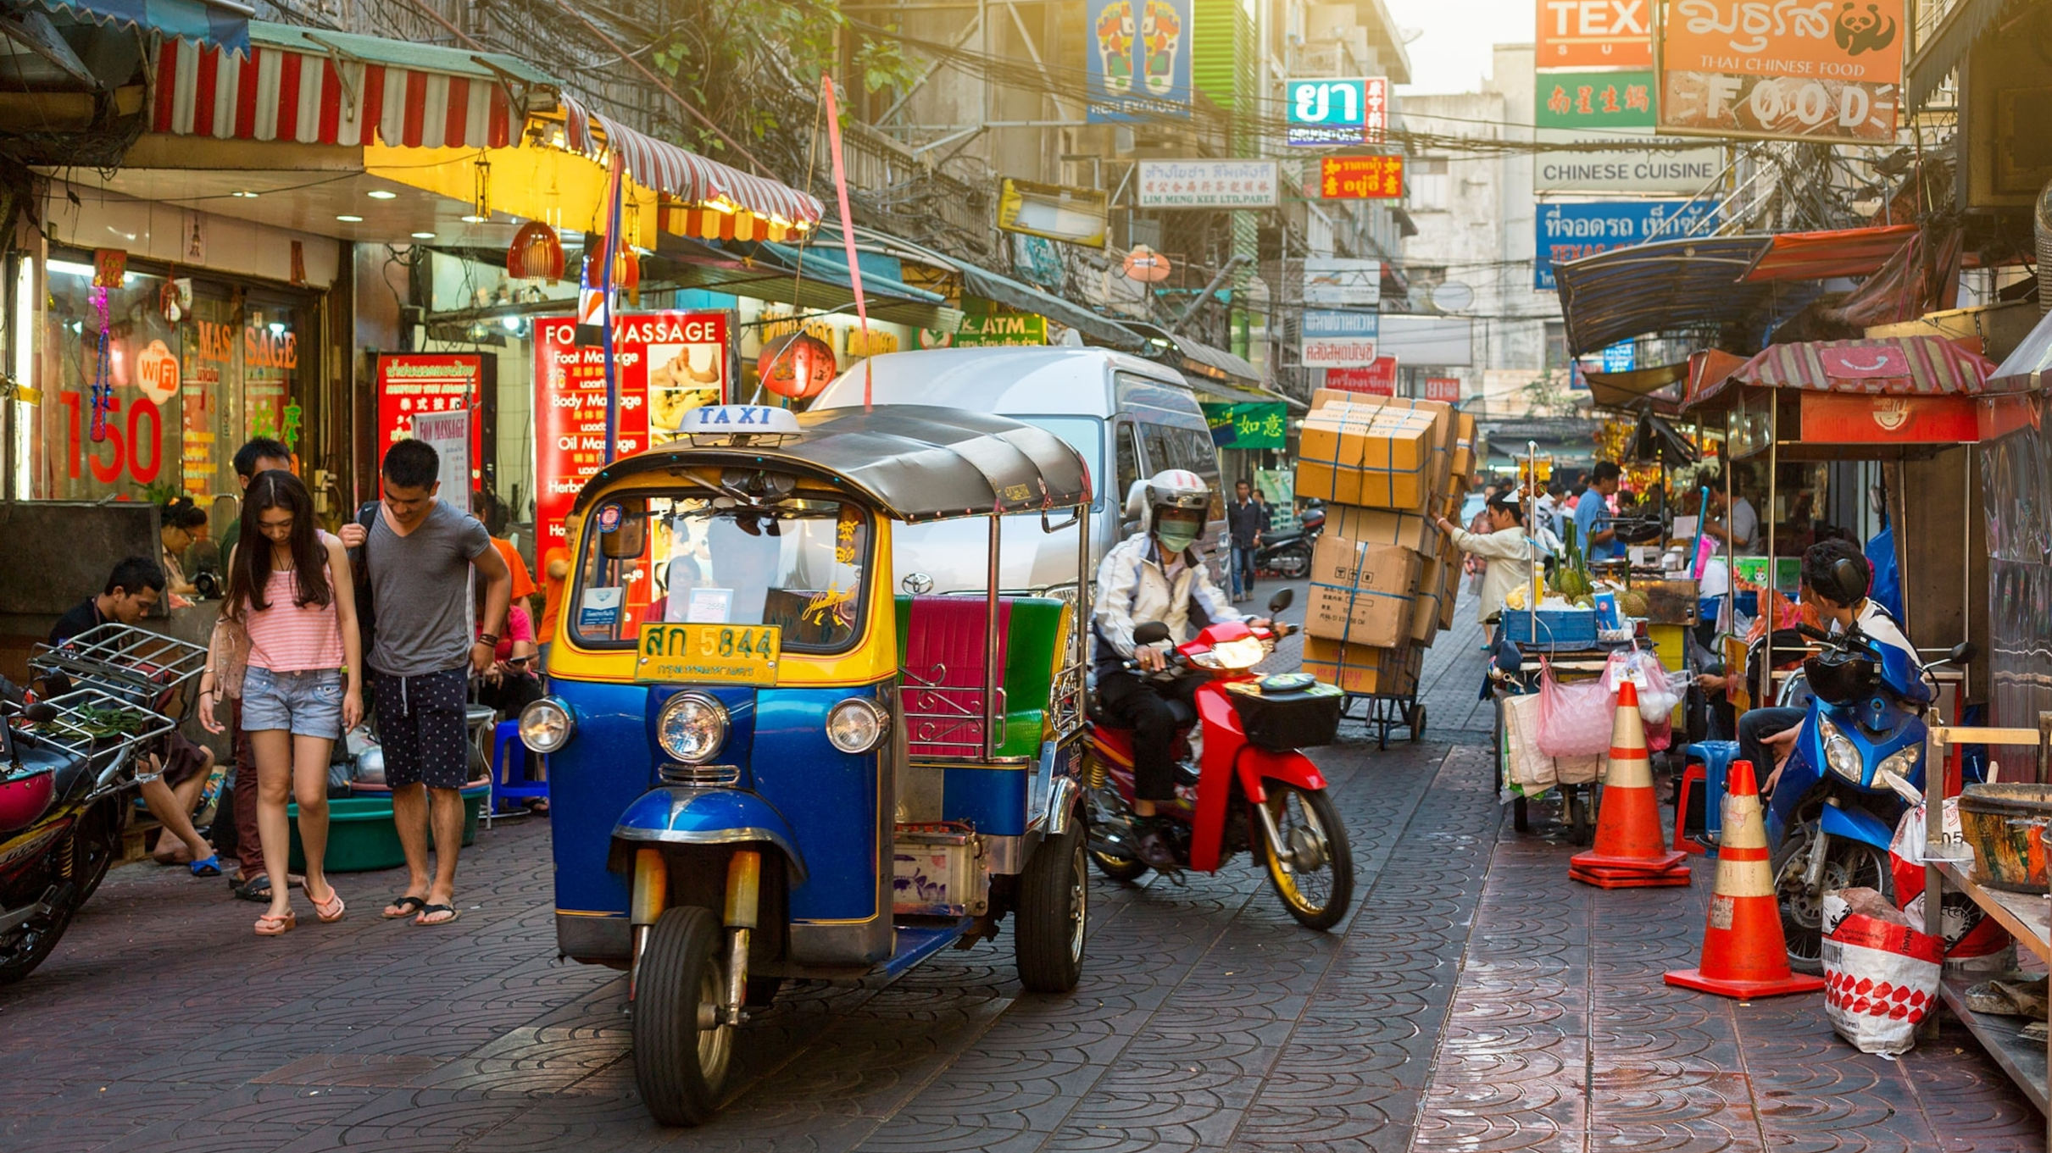
Conclusion Pt.2
Will their population level out or continue to grow?
Thailand's population at the moment is extremely unstable and is experiencing many problems. Thailand's population trend is increasing at an annual growth rate of 0.25%. At this moment and moving forward Thailand's population is going to be decreasing. Experts have said that the baby bust will cause Thailand's population to plummet by one third from 70 million to about 47 million. The International Monetary Fund even forecasted that the shrinking labor force will hinder economic growth by as much as 1 percent every year for the next 20 years.
Birth rates have dropped sharply from more than 6 children per woman in 1960 to 1.5 in 2015. Thailand is trying to increase the birth rate since 2000, Thailand has urbanized faster than any other big country besides China, which is the main reason fertility rates are falling now.
The decline was rapid from 1950-65 but since then the pace of decline has slowed. With international immigration and mortality relatively low and unlikely to change dramatically, fertility is the major factor determining population growth in Thailand.
The overpopulation in Bangkok has caused an increase in traffic, poverty, air and water pollution. One of Thailand's biggest issues is that its capital city is dramatically larger than its other cities in the province. Bangkok is Thailand's main generating center where everything happens . All of Thailand's major universities, large companies, hospitals, headquarters of banks, corporations, stock exchange, broadcasting, media, and most importantly the branches or government. The population for Bangkok is about 10.72 million and the second largest city is Nonthaburi with 254,375.
Recommendations for this country on how to deal with population.
Recommendations for the country would be having things more spread out and not making the capital city so overpopulated. Instead of having everything in one city splitting and moving them to other cities in different provinces allows a more equal population ratio. Having all the headquarters, universities, hospitals, and government branches in one area draws everyone to that place and makes the population uneven. Once things are more spread out the air pollution should reduce and there will be lower social issues. Also focusing on their water pollution is beneficial because it will help decrease diseases and increase food production. These can only change with a proper government and in Thailand the monarchy is corrupted. So, for all these issues to have a solution the main place to start would be changing the governments system.

