Slide 1
Electromagnets and the Industrial Revolution
Sam Belyea

Slide 2
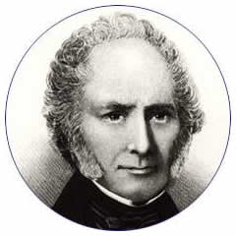
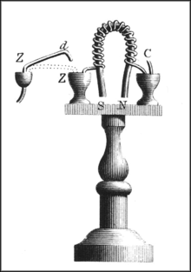
Invention of the Electomagnet
The electromagnet was invented by William Sturgeon in 1824.
Sturgeon was interested in creating a magnet which he control the strength. The first electromagnet was made from a horseshoe shaped piece of iron wrapped in bare copper wire.
“Https://En.wikipedia.org/Wiki/William_Sturgeon.” Https://En.wikipedia.org/Wiki/William_Sturgeon.
“Https://En.wikipedia.org/Wiki/William_Sturgeon.” Https://En.wikipedia.org/Wiki/William_Sturgeon.

Slide 3
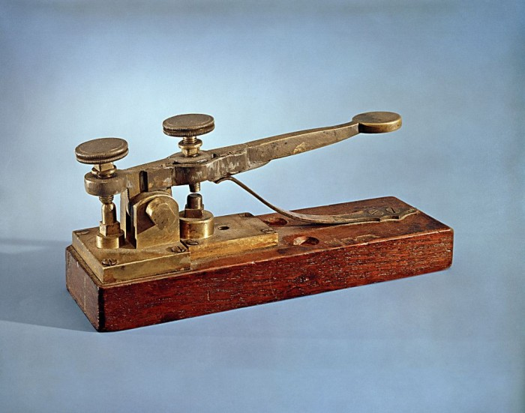
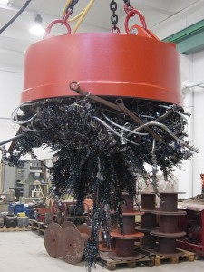
Purpose and Use of Electromagnets during the Industrial Revolution
Electromagnets are important because they are stronger than regular magnets, their strength can be controlled by adjusting the current, and they can be turned off and on.
Electromagnets were used in two ways during the Industrial Revolution; machinery and communications. Electromagnets are stronger than other magnets and were used to do more work (like picking up junk in a junkyard). They were also used to operate a telegraph with longer range, better reliability and speed.
“Http://Www.moleymagneticsinc.com/24-Volt-Scrap-Magnets/.” Http://Www.moleymagneticsinc.com/24-Volt-Scrap-Magnets/.
“Https://Stillunfold.com/Science/Surprising-Facts-about-First-Telegraph-First-Message-Morse-Code.” Https://Stillunfold.com/Science/Surprising-Facts-about-First-Telegraph-First-Message-Morse-Code.

Slide 4
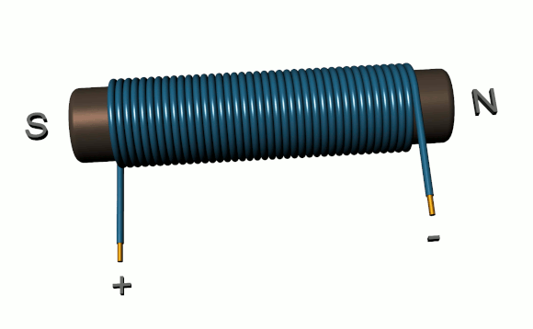
Problem with the Electromagnet
When the electromagnet was invented in 1824, Sturgeon used iron wrapped in bare copper wire. Since the wire was uninsulated, it could only be wrapped in a single, spaced out layer. This limited the strength of the magnet.
“Https://En.wikipedia.org/Wiki/Electromagnet.” Https://En.wikipedia.org/Wiki/Electromagnet.

Slide 5
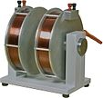
A Solution
In 1830, Joseph Henry started using insulated wire to wind multiple layers around the metal. This allowed more current to be passed through, creating more powerful magnets.
“Https://En.wikipedia.org/Wiki/Electromagnet.” Https://En.wikipedia.org/Wiki/Electromagnet.

Slide 6
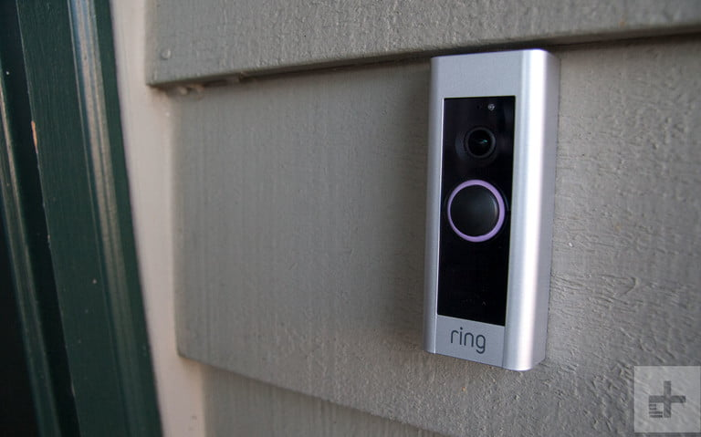
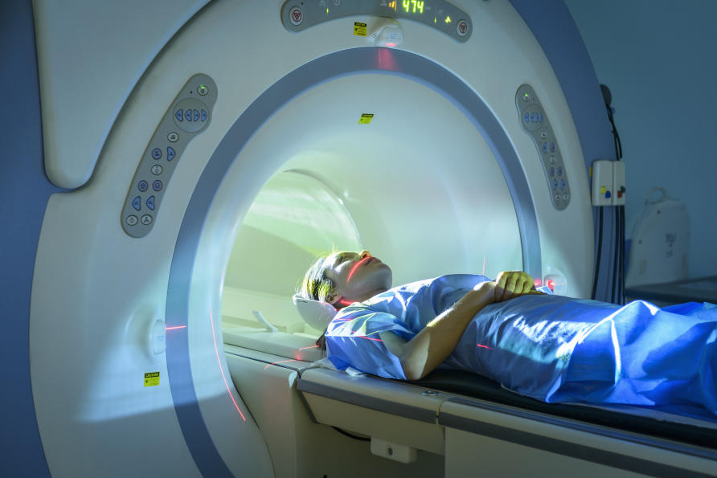
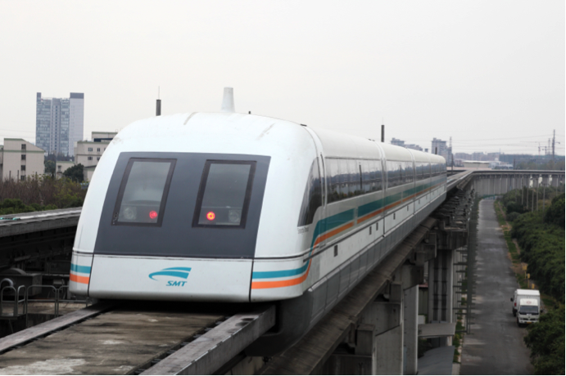
Electromagnets Today
Electromagnetics forces are used today to create electric motors and generators. Because of the ability to create powerful magnetic fields, electromagnets are used in medical equipment such as MRI machines. They are used in everyday devices such as music equipment, doorbells, and induction heating for cooking. They are used for heavy lifting. Electromagnets are used in magnetic levitation (maglev) high speed trains.
“Https://Www.digitaltrends.com/Home-Security-Reviews/Ring-Video-Doorbell-pro-Review/.” Https://Www.digitaltrends.com/Home-Security-Reviews/Ring-Video-Doorbell-pro-Review/.
“Https://Www.healthline.com/Health/Mri-vs-Pet-Scan.” Https://Www.healthline.com/Health/Mri-vs-Pet-Scan.
“Https://Www.autotrainingcentre.com/Blog/Hover-Boards-Maglev-Trains-Levitating-Cars-next/.” Https://Www.autotrainingcentre.com/Blog/Hover-Boards-Maglev-Trains-Levitating-Cars-next/.

Slide 7
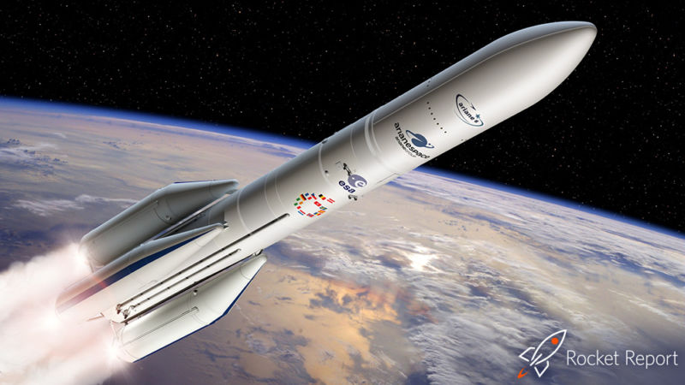
The Future
In the future, I think electromagnets will advance transportation even further. If a train can be moved by electromagnets, why not a rocket?
Rockets currently run off, of chemical propulsion. I think if they can be propelled by electromagnets they could go faster and further and possibly be safer. Electromagnets made trains faster so I think they can make rockets faster too.
If rockets were safer and faster, more people could travel to space and maybe be able to colonize space.
Https://Arstechnica.com/Science/2019/09/Rocket-Report-Blue-Origin-Crew-Flights-May-Slip-to-2020-Final-Soyuz-Fg-Launch/.” Https://Arstechnica.com/Science/2019/09/Rocket-Report-Blue-Origin-Crew-Flights-May-Slip-to-2020-Final-Soyuz-Fg-Launch/

Slide 8
My Design:
I designed this electromagnet car on photoshop. I hope that electromagnets can make cars hover like they do for trains.

Slide 9
Bibliography
William Sturgeon and the Invention Of the Electromagnet
Mary Bellis - https://www.thoughtco.com/who-invented-the-electromagnet-1991678
What Are Electromagnets Used For in Everyday Life?
Kevin Lee - https://sciencing.com/what-electromagnets-used-everyday-life-4703546.html
Electromagnet
https://nvaughn.weebly.com/electromagnet.html
What Are The Uses Of Electromagnets?
Matt Williams - https://www.universetoday.com/39295/uses-of-electromagnets/

