Slide 1
Death of a Salesman Scene 4 – Memory 2
Presentation by Parker Lowes, Sam Bok and Jerome Lee

Slide 2
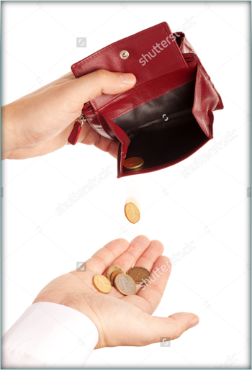
Perception and Debt
Though he takes pride in his son, Biff, for his popularity among his peers, he is not as revered.
Biff has the popularity of his peers, but Willy has the adequate work ethic.
Happy is more like Willy than Biff is since he is less popular but also worked hard in the past.
Willy's admiration for Biff's past popularity, causes Harry to be overshadowed by his brother in the memories
Linda implies that he makes decent money, but expenses build up – in debt
Revealed that he’s not as well-liked as he thinks (insecure about weight and talkative)
A salesman supposedly compared him to a walrus.

Slide 3
Cheating
After admitting his insecurities, Linda complements Willy so feels better, this brings back memories of when he was cheating on another woman during a trip.

Slide 4
The Stockings
Willy feels guilty that he bought stockings for the woman in his affair but can’t buy them for Linda and is angry he can’t afford them.
“they’re so expensive” (39) - Linda

Slide 5
Works Cited
Miller, Arthur. Death of a Salesman (Penguin Plays). New York: Penguin Books USA, 1998. Print
Images:
Bufflamano, Lucio. “Facts about Cheating & Cheaters (Science vs Myths).” The Power Moves. Accessed on 7 Jan. 2023
“[Hot Item] High Precision Weighing Scale with Big Display 30kg (GC-27).” Made-In-China, Focus Technology Co., Ltd. Accessed on 7 Jan. 2023
“Lack of Money Clipart.” Clipground. Accessed on 7 Jan. 2023

