Slide 1
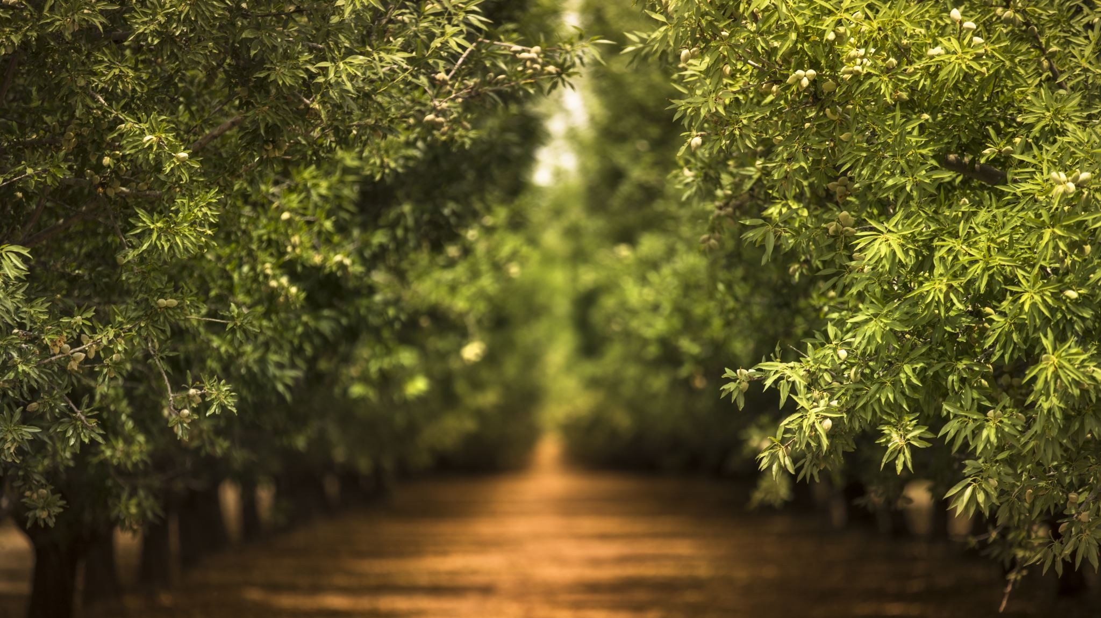
Drayton Valley
Saylor Kuefler

Slide 2
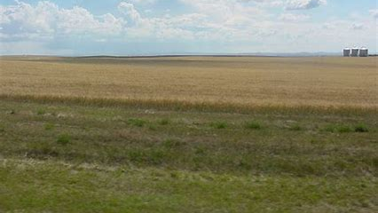
Physical Landforms
Physical landforms
North Saskatchewan river
Forests and agriculture
Flat land
Why they exist:
North Saskatchewan river- from the Saskatchewan Glacier (in the Columbia Icefields)
Forests and agriculture
Flat land- volcanic action in Canadian Shield spread material across int. plains in sweeping,
rolling action= soil is layered
Economic activities
River: provides recreation; camping, swimming, canoeing, fishing, tourism, and gold panning
Forest and agriculture: Forestry industry provides logging, pulp mill, the oil field and, increases employment
Flat land: provides space (several hundred km) for oil wells and pump jacks. Farming

Slide 3
Climate Characteristics
Climate Characteristics
Continental climate (dry, sunny, and cold winters) also has very hot summers because there’s lots of wind and no big bodies of water (severe)
Four seasons
Frontal precipitation à cold front & warm front (harsher rainfalls)
Why they exist:
Continental climate Drayton valley is a continental climate because of its location!
Four seasons there are four seasons because
Frontal precipitation the rain is harsher because there are two different temperatures, no bodies of water, and no mountains
Economic activities
Continental climate: because of the long winters & amount of snow increases tourism through winter sports such as snowmobiling, and ice fishing
Companies that mainly have winter-based supplies such as ice fishing and snowmobiling will make good money throughout the winter!

Slide 4
Vegetation
Vegetation
Land - > fertile
Grasses -> Kentucky bluegrass and red fescue.
Forests -> habitats
Logging/trees -> pine, spruce
Why they exist:
Fertile land -> Organic matter and plant nutrients
Grasses ->
Forests ->
Logging ->
Economic activities:
Forestry-> jobs (logging) get lots of wood – lumber-> money $$$$$$$$$$$
Farms with cows= beef and other produce

Slide 5
Environmental Issue
The Frontier oilsands mine is being built.
- Frontier oilsands mine located in northeastern alberta is being built so they can extract oils from the mines for factories, cars, planes, ect.

Slide 6
Issues/Consequences
"The Frontier mine will make it super difficult for Canada to meet its climate commitments." => the oil sands are emitting too many greenhouse gases per year. Climate change strongly effects the oil demand and any change will cause difficulties.
"Almost 3,000 hectares of forest will be cut down to make room for the mine." => animals will lose their habitats and have no home.
"Nobody knows how or when the site will be cleaned up." =>if nobody can say when or how the site will be cleaned it is possible the builders don’t know or don’t care, and it could be held off for longer than it should.

Slide 7
Solution
The problem is that we want to use oil as a form of energy for example gas for planes and cars.to prevent the negative enviornmental issues we should rely more on other forms of energy such as wind -> windmills, heat -> sun, water, and electricity.
In 50 years frrom now we will be using those to our advantage. We will also hopefully have all electric cars,planes, boats, ect. in replace with gas...

Slide 8
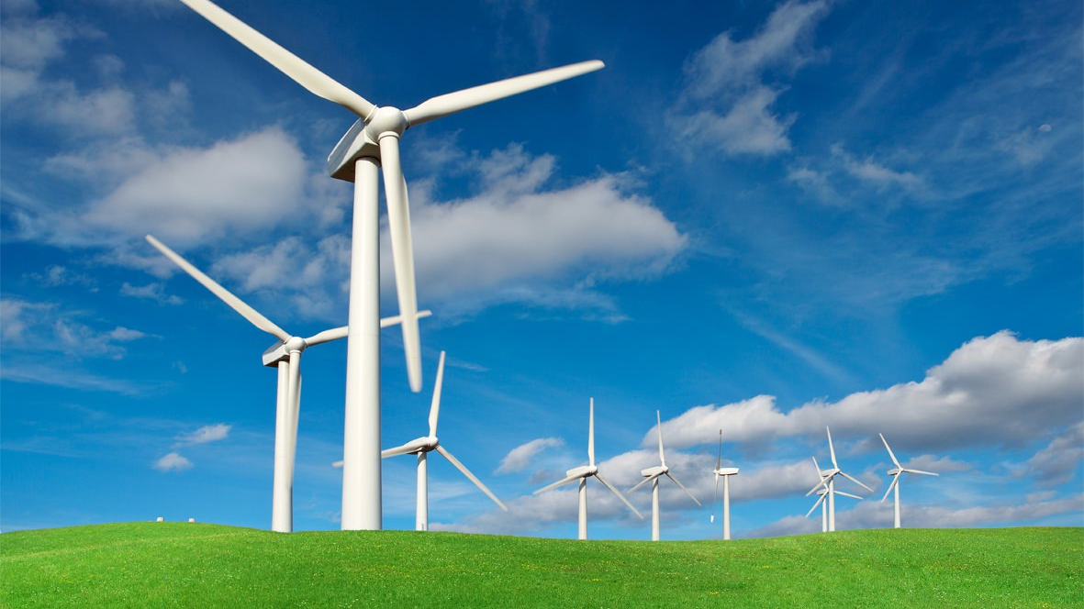

Slide 10
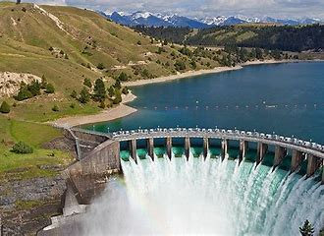

Slide 11
Bibliography
“Geography.” ThoughtCo, ThoughtCo, 22 May 2019, www.thoughtco.com/geography-4133035.
The Narwhal. “10 Things You Need to Know about the Massive New Oilsands Mine That Just Got a Green Light.” The Narwhal, The Narwhal, 29 July 2019, thenarwhal.ca/10-things-you-need-to-know-about-the-massive-new-oilsands-mine-that-just-got-a-green-light/.
National Geographic Society. “Landform.” National Geographic Society, 9 Oct. 2012, www.nationalgeographic.org/encyclopedia/landform/.
Weather & Climate.” Alberta Canada, www.travelalberta.com/us/plan-your-trip/weather-climate/.
“History.” RSS 20, rally.hondaracingcorporation.com/history/.

Slide 12
Reflection
A) I was easily able to find my environmental issue. I found the issues and consequences through articles and sites including the Narwhal
B) I did not work from a backwards design because I was not fimiliar with the stratagy. I found it easy to "dream of the future/identify solutions" especially because I used the images as inspiration.
C) I am satisfied with my solution and designs because I worked hard on them
D) In the future I would spend more time on the big issue and research furtur into the problem, so I understood it a bit more before I moved onto the consequences.

