Slide 1
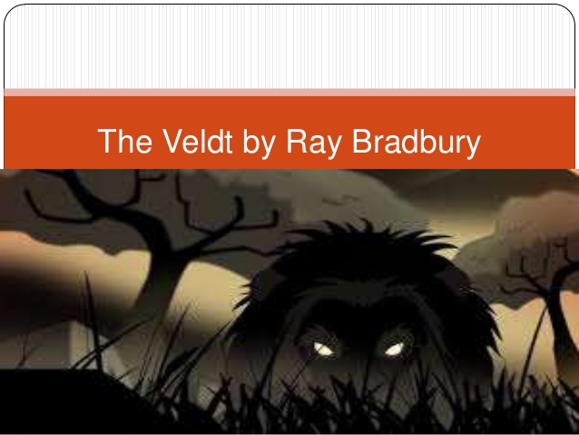
The Veldt Infographic
By: Maddie, Isabella, and Tayla

Slide 2
By: Isabella
This story takes place in a futuristic setting full of modern technology that does pretty much everything for you. Forget chores and brushing your teeth!
The parents are wealthy so they can afford a thirty thousand dollar program installed in their home just to make life effortless. They bought a room which they called “The Nursery” to entertain the children, it was definitely a mistake.
Character:
Setting:
There are five characters introduced in this story, George Hadley, Lydia Hadley, Peter, Wendy, and David McLean. George and Lydia are the Mom and Dad; Peter and Wendy are the offspring; David McLean is the psychologist.
George and Lydia play the role as the concerned parents for their kid’s well being. Throughout the story they try to shut down the nursery to help Peter and Wendy’s future mental health. Thank David McLean for that idea. He helped change the parent’s perspective on the existence of the nursery. Peter and Wendy play the not so innocent son and daughter of Mr. and Mrs. Hadley. They were raised to have an easy life, no problems. The house became a parental figure to the kids. Then out of no where the parents started taking away their only known ways of life. Of course they lashed out, they threatened to take away their “house mom” or whatever you want to call it. Overall this story is very dark.

Slide 3
By: Maddie
The plot of “The Veldt” is the dangerous up rise of addiction to electronic devices. In the story Peter and Wendy, seem to be oddly attached to their nursery. A nursery is a room that has four screens on each wall. When the kids and only the kids think of something the nursery changes. One day their parents, George and Lydia, went into the kid’s nursery and found something some what disturbing. The nursery portrayed a veldt with lions eating things, and horrific screams in the background. This worries George and Lydia because kids shouldn’t be seeing this stuff. The parents decide to talk to a psychologist, and they want to move, however the kids are not happy about that and who knows what they would do to stop the move…0I
Plot:

Slide 4
By: Tayla
The main conflict in the story is between the parents and the kids because the kids have started to rely only on the electronics in house and replace the parents with them.
Foreshadowing:
Conflict:
One of the forms of foreshadowing in the story is when the parents were finding their belongings in the nursery and the lions were chewing on them. That’s a form of foreshadowing because it means the kids were imagining that the lions were eating the parents

